Slide 1
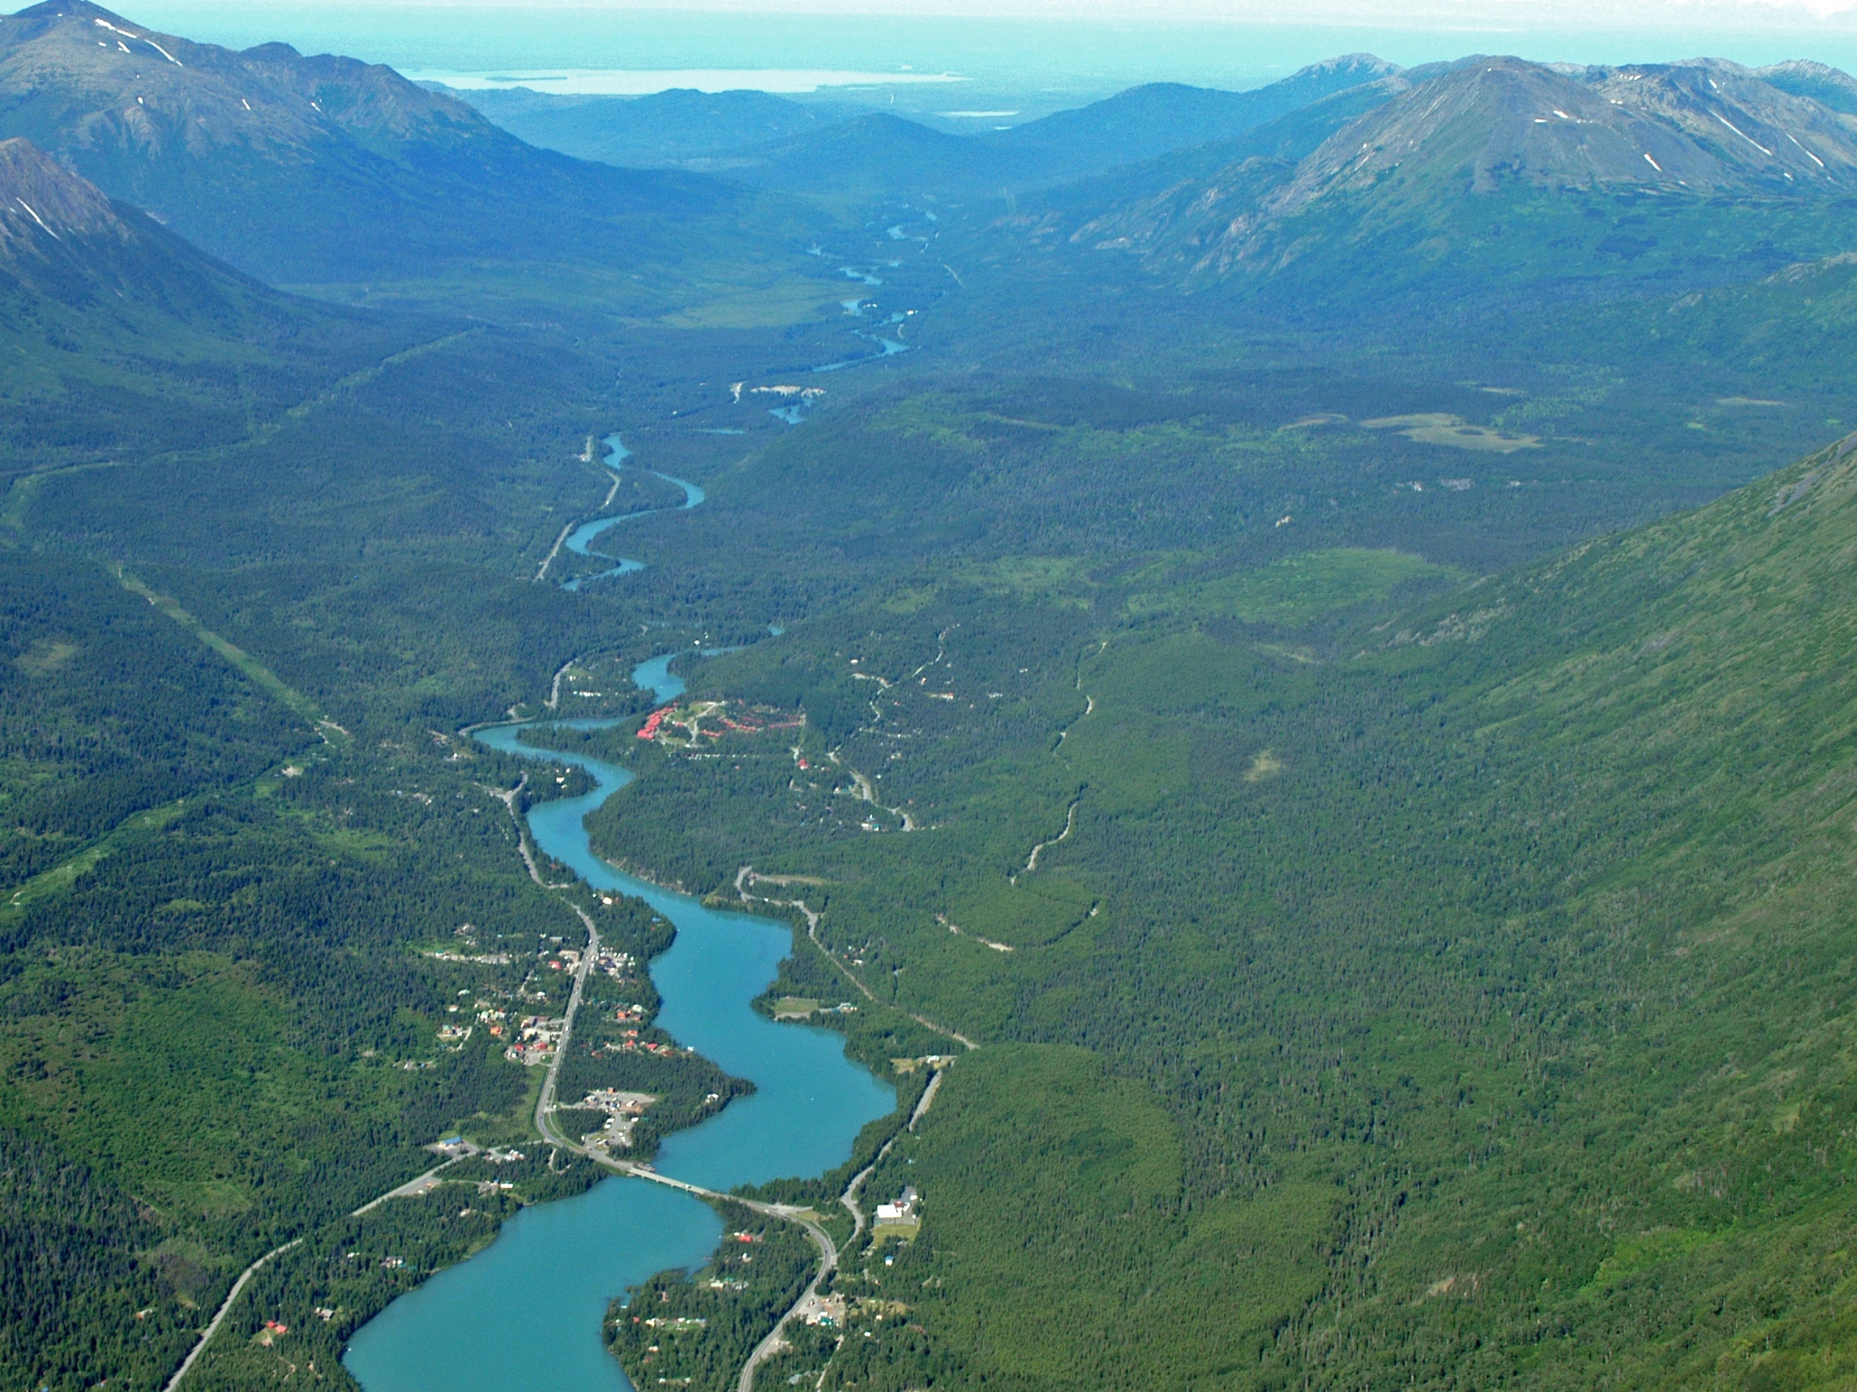
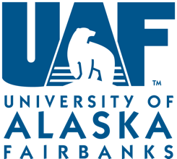
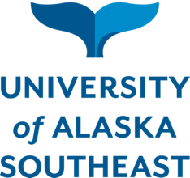




Future of Salmon
in the Face of Change
Erik Schoen, Mark Wipfli, Jamie Trammell, Daniel Rinella, Angelica Floyd, Jess Grunblatt, Molly McCarthy, Benjamin Meyer, John Morton, Jim Powell, Anupma Prakash, Matthew Reimer, Svetlana Stuefer, Horacio Toniolo, Brett Wells, and Frank Witmer
Photo: John Schoen

Slide 2
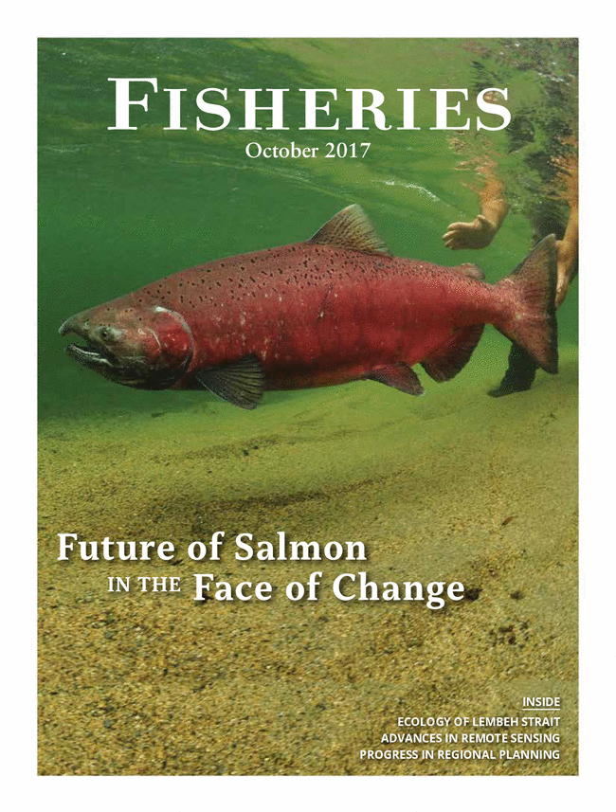
Synthesis paper featured on cover of Fisheries, October 2017 (open access)
Schoen, E.R., Wipfli, M.S., Trammell, E.J., Rinella, D.J., Floyd, A.L., Grunblatt, J., McCarthy, M.D., Meyer, B.E., Morton, J.M., Powell, J.E., Prakash, A., Reimer, M.N., Stuefer, S.L., Toniolo, H., Wells, B.M., and Witmer, F.D.W. 2017. Future of Pacific Salmon in the Face of Environmental Change: Lessons from One of the World's Remaining Productive Salmon Regions. Fisheries 42(10): 538-553.

Slide 3
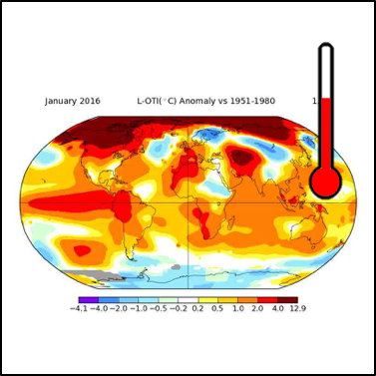
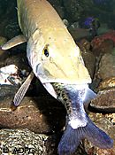
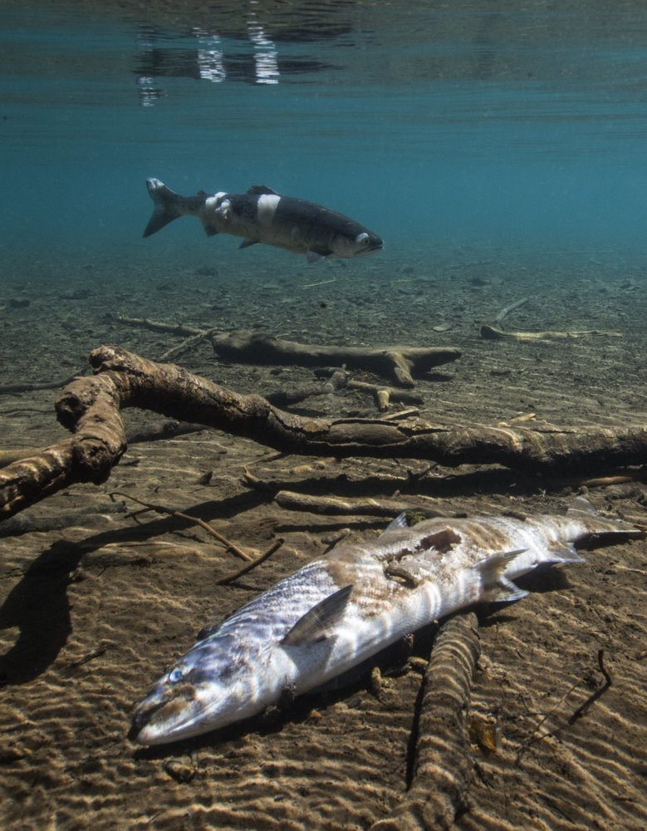
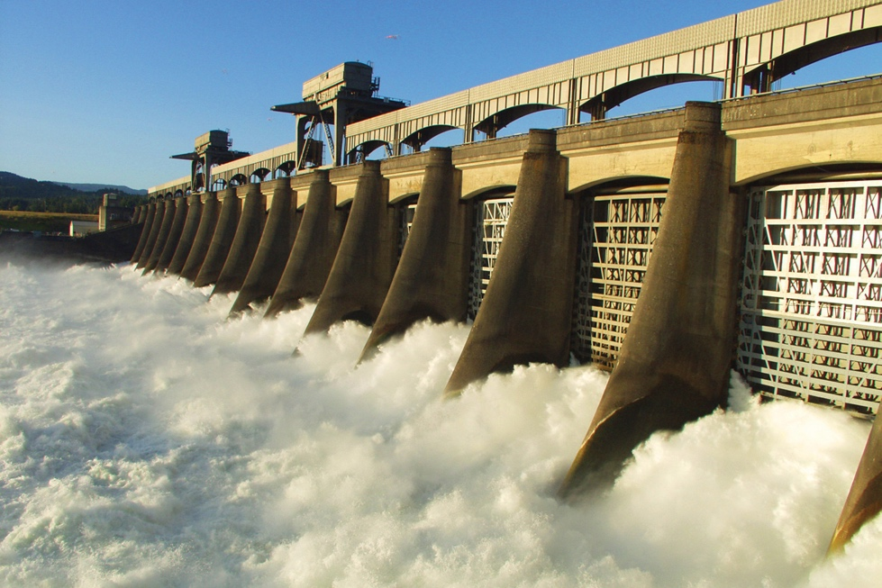
Pacific salmon face serious challenges due to environmental change
NASA
ADF&G
BPA
Seattle Times

Slide 4
Yet, the total abundance and harvest of wild Pacific salmon are at historic highs
Pacific salmon returns (total run size)
Irvine and Ruggerone 2016, Ruggerone and Irvine 2018
Pink, Chum, and Sockeye Chinook and Coho

Slide 5
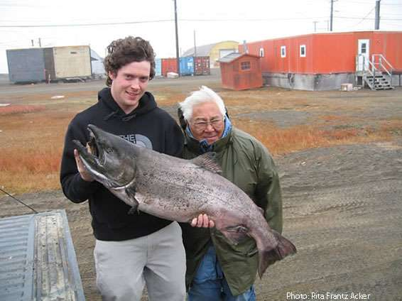
Opportunities?
???
Challenges

Slide 6
Gulf of Alaska
Rivers draining into the Gulf of Alaska
Produce 1/3 of the world’s wild salmon
Heavily influenced by glaciers
Rapidly changing environment

Slide 7
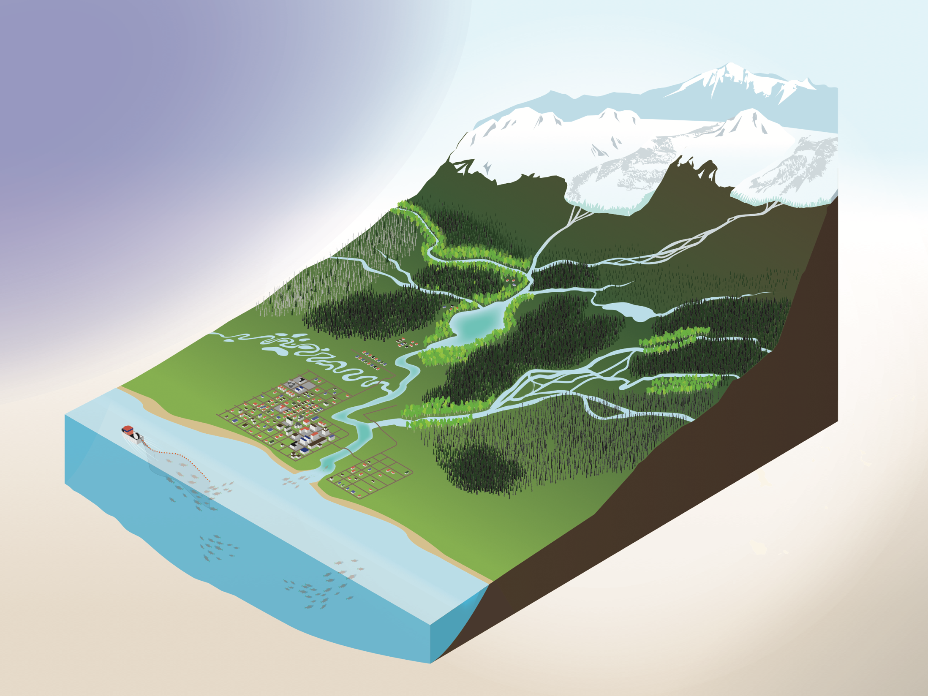


Changes facing salmon ecosystems in the Gulf of Alaska region
Focus on coupled freshwater and terrestrial habitats
Climate change:
Air temperature
Precipitation
Landscape change:
Glacier melting
Wetland loss
Wildfire and bark beetles
Human development
Invasive species
Fisheries
Salmon habitat:
Loss/gain
Stream discharge
Stream temperature
Salmon abundance
Illustration by Dixon Jones

Slide 8
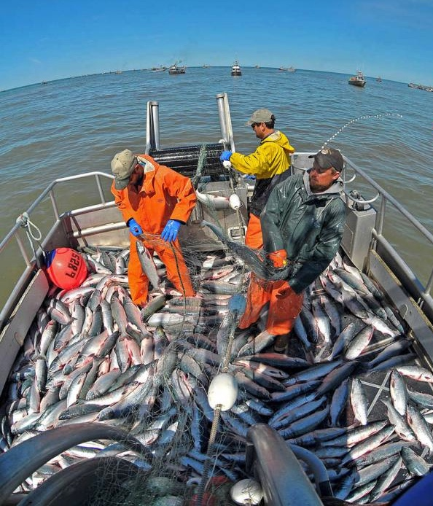
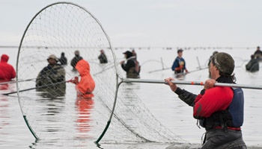
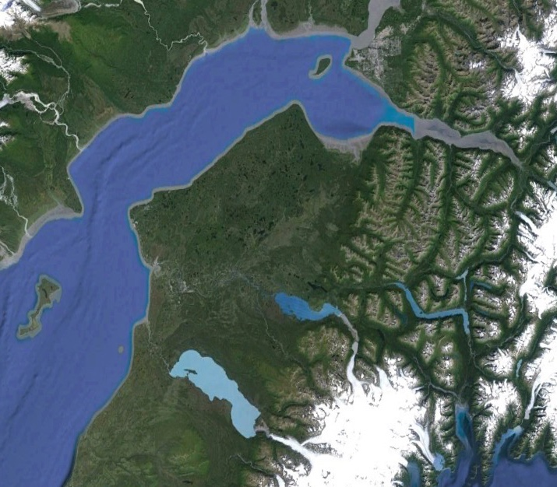
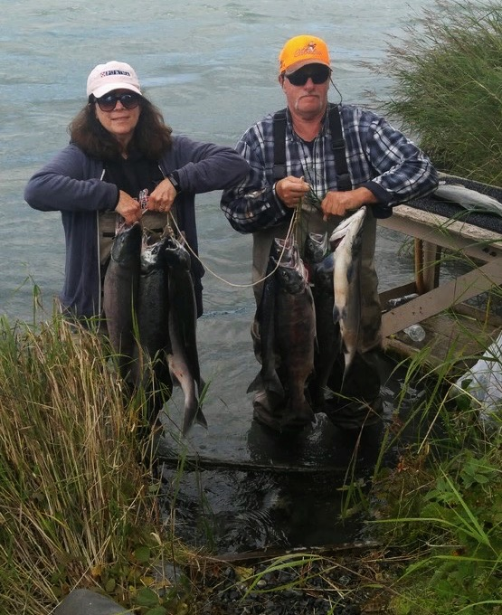
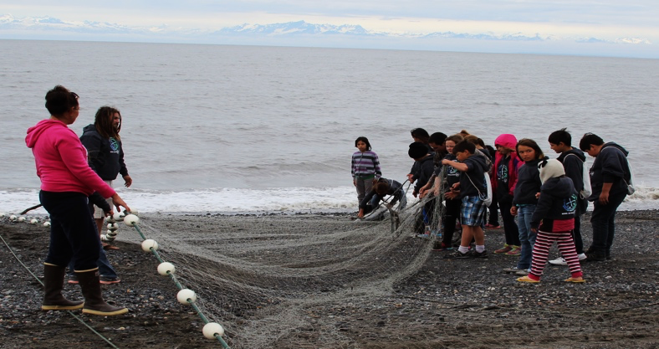
Focal case study: The Kenai River, Alaska
An exceptionally productive watershed facing rapid change
Supports major salmon fisheries
Recent Chinook Salmon declines have raised concerns about resilience of salmon populations and fisheries
Anchorage
Jodyo photos
Kenai River
Peninsula Clarion
Courtney Breest
Molly McCarthy Cunfer

Slide 9


Climate change
Alaska has warmed at more than twice the rate of the rest of the US over the past 60 years (Chapin et al. 2014)
In the Kenai River watershed:
Historical changes (NWS)
  Rapidly warming air temperatures during all seasons
  Drier summers, wetter falls
Future projections (SNAP)
  Warming predicted to continue or accelerate in future
  Future precipitation trends uncertain

Slide 10
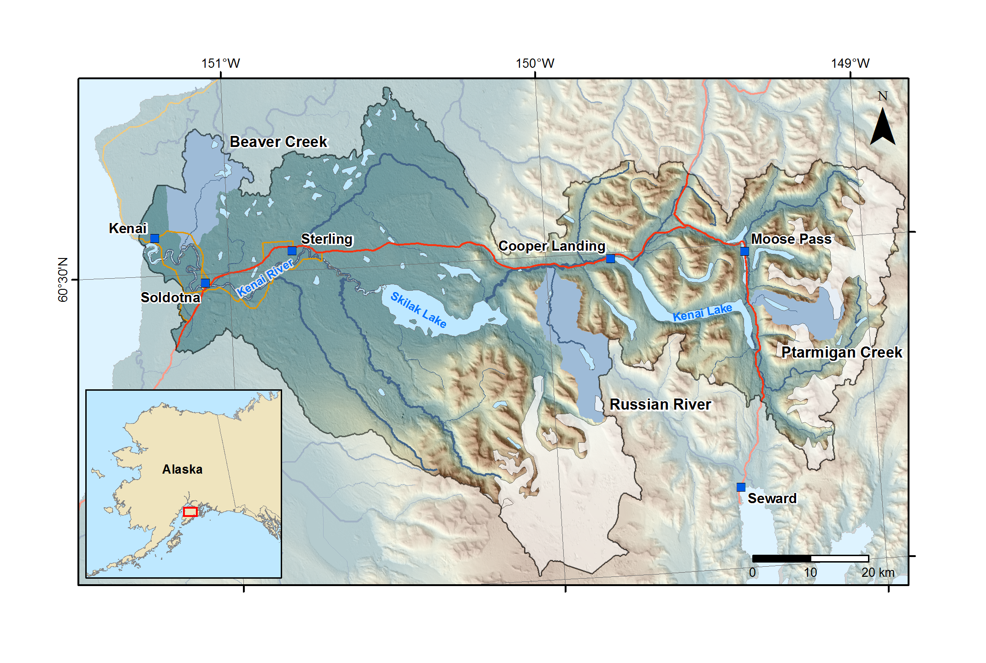
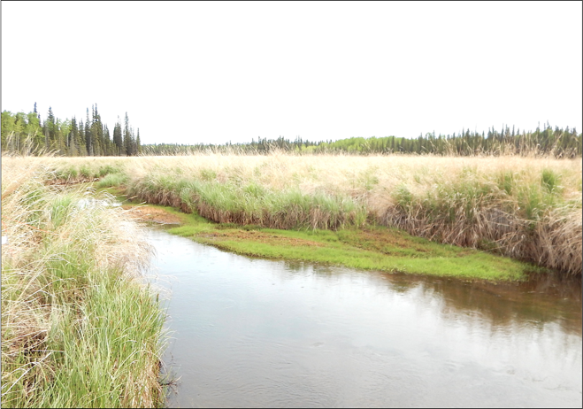
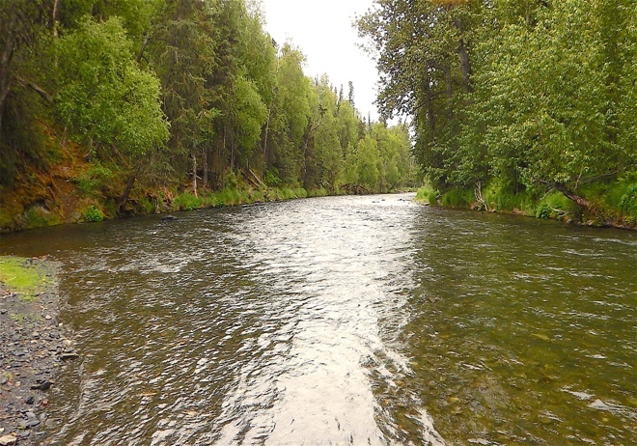
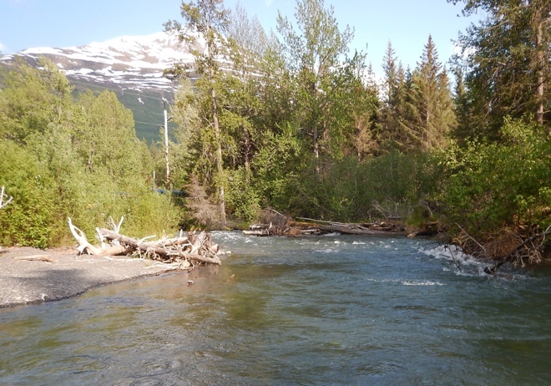
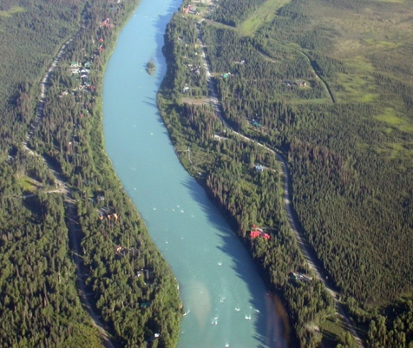
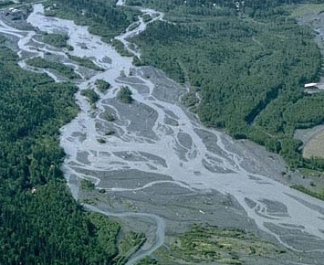
Climate change affects salmon habitats differently across the diverse landscape
Top photos: Ben Meyer
John Schoen
Marli Miller, U Oregon
See Ben Meyer’s talk for the juicy details

Slide 11
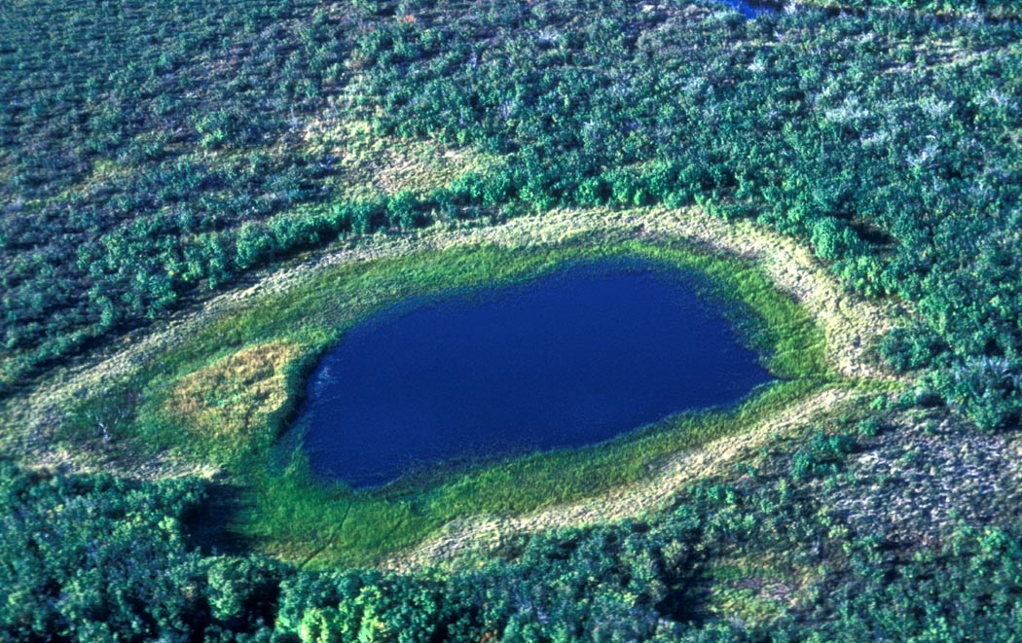
Landscape change: Drying wetlands
Wetlands in the Kenai Lowlands have shrunk by 9% per decade since the 1950s (Berg et al. 2009)
Data from Berg et al. 2009
US Fish and Wildlife Service

Slide 12
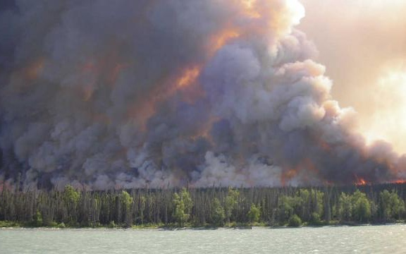
Landscape change: Increased wildfire frequency
Lightning-caused wildfires have increased in frequency in Kenai Peninsula Borough since 1988 (Poisson regression; p < 0.05)
Human-caused wildfires also more frequent, non-significant trend (p = 0.07)
Data from Alaska Fire Service
US Fish and Wildlife Service

Slide 13
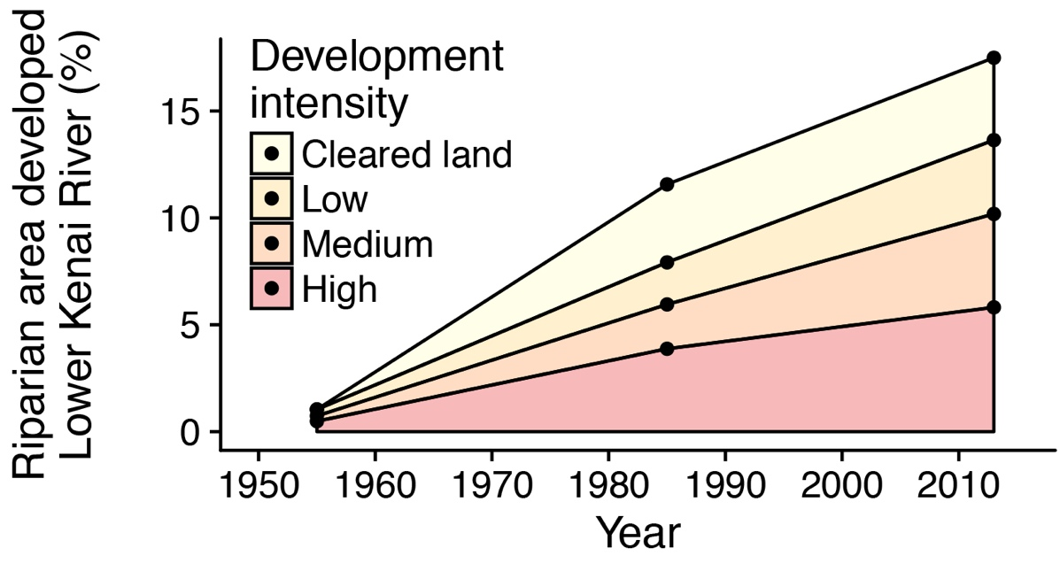
Landscape change: Human development
Footprint of human development has expanded more than 20-fold since 1950s
Development is concentrated along the lower Kenai River, key Chinook habitat
Kenai River

Slide 14
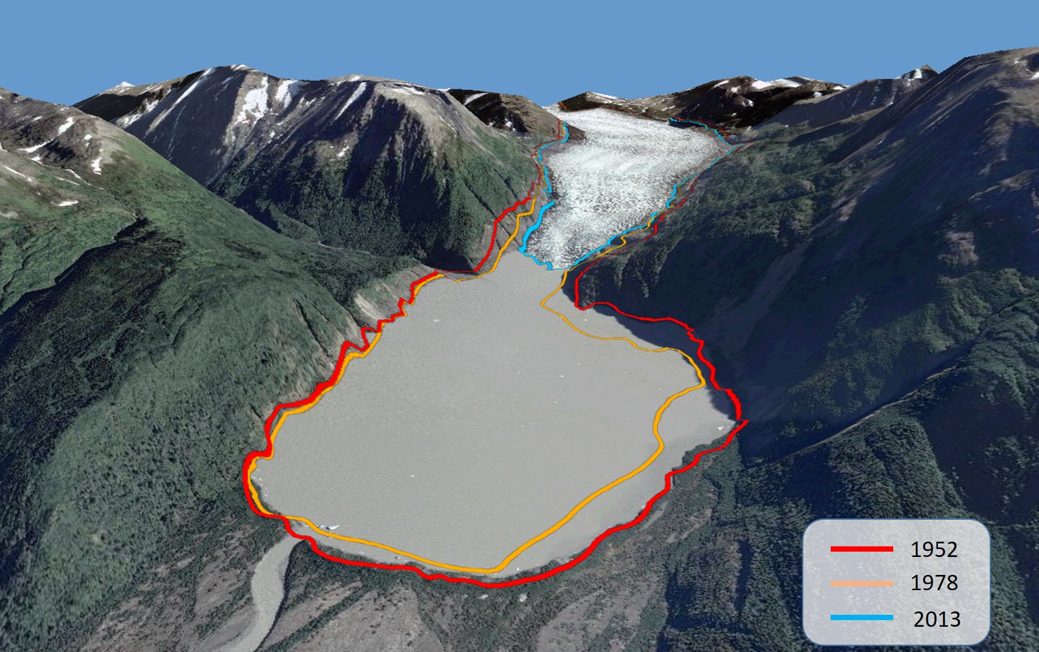
Landscape change: Melting glaciers
Glaciers are rapidly losing mass throughout Gulf of Alaska region (Arendt et al. 2002)
Harding Icefield thinned by 30 m from 1950-1999 (VanLooy et al. 2006)
Skilak Glacier
Data from O’Neel et al. 2014

Slide 15
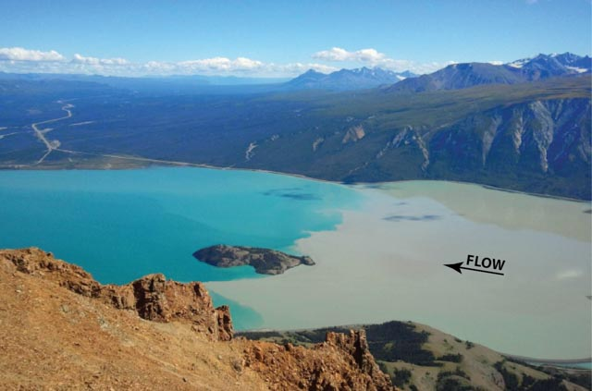
Risks of glacier mass loss:
Reduced streamflow into salmon habitats
Before 2016
Kluane Lake
Glacial river
Francis Gauthier

Slide 16
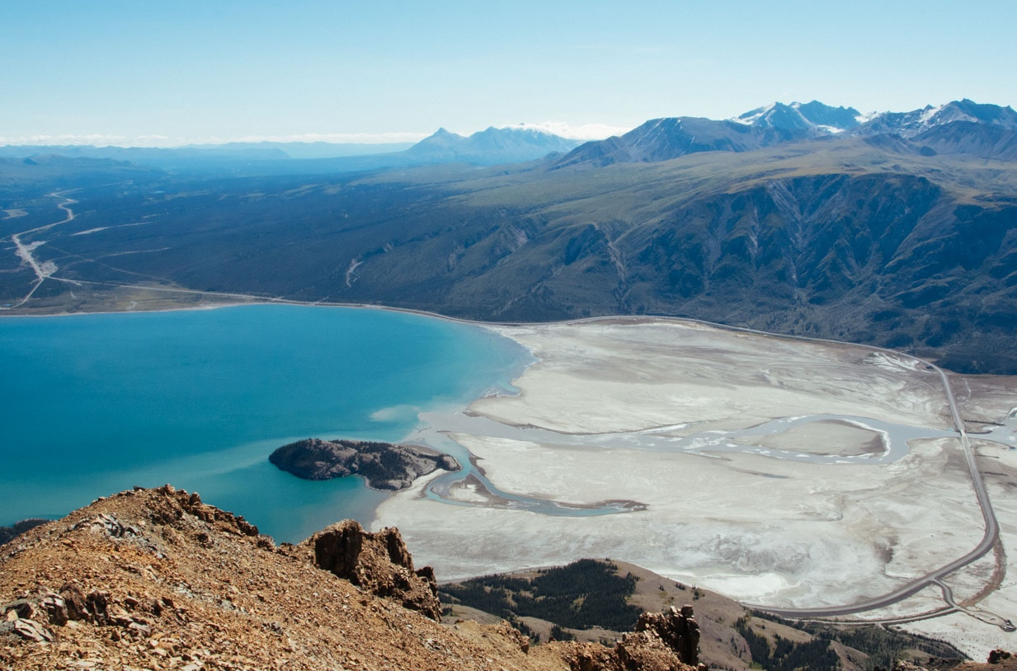
Risks of glacier mass loss:
Reduced streamflow into salmon habitats
2016-present
Meltwater from retreating glacier now flows into another drainage (Shugar et al. 2017)
Lake level is dropping rapidly
Chum salmon losing spawning habitat in Kluane River downstream

Slide 17
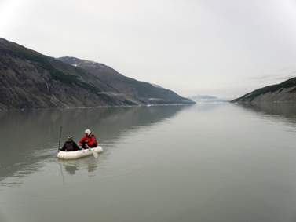
Opportunities due to glacier mass loss:
New habitats created, habitat quality improved
2008
New proglacial Melbern Lake formed in Alsek watershed during 1980s-2000s: Half the size of Kenai Lake

Slide 18
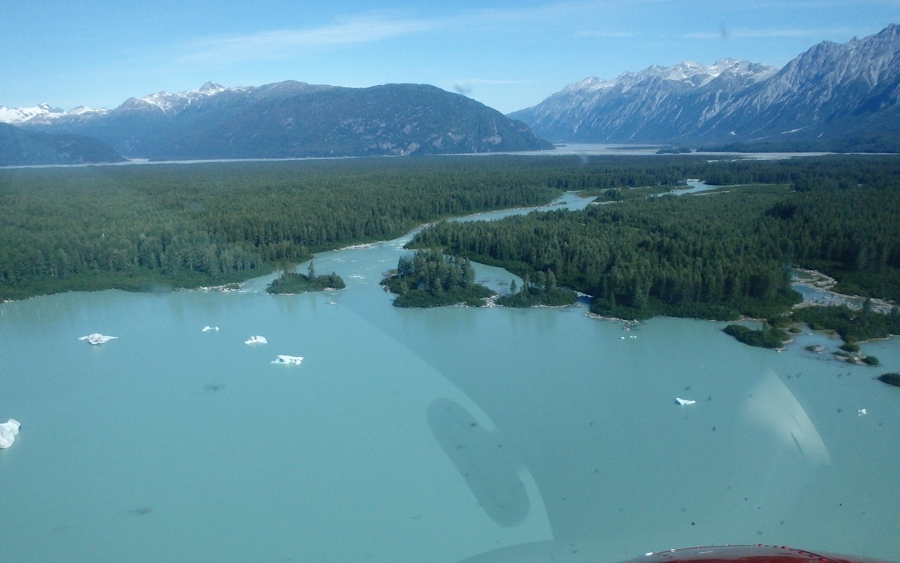
Opportunities due to glacier mass loss:
New habitats created, habitat quality improved
2014
New proglacial Melbern Lake formed in Alsek watershed during 1980s-2000s: Half the size of Kenai Lake
Water turned from gray to blue between 2008-2014
Al von Finster

Slide 19
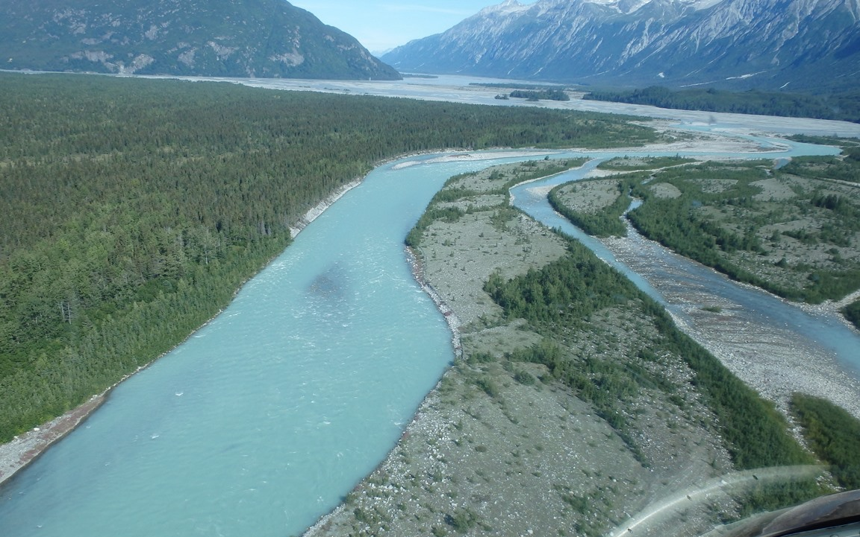
Opportunities due to glacier mass loss:
New habitats created, habitat quality improved
2014
New proglacial Melbern Lake formed in Alsek watershed during 1980s-2000s: Half the size of Kenai Lake
Water turned from gray to blue between 2008-2014
Lake and outlet river expected to be colonized by Sockeye and Chinook salmon, benefiting Alaskan fisheries (Al von Finster, Yukon River Panel, pers. comm. )
Al von Finster

Slide 20
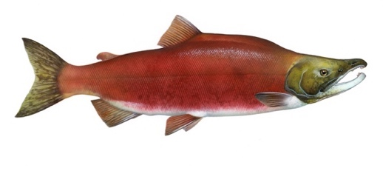
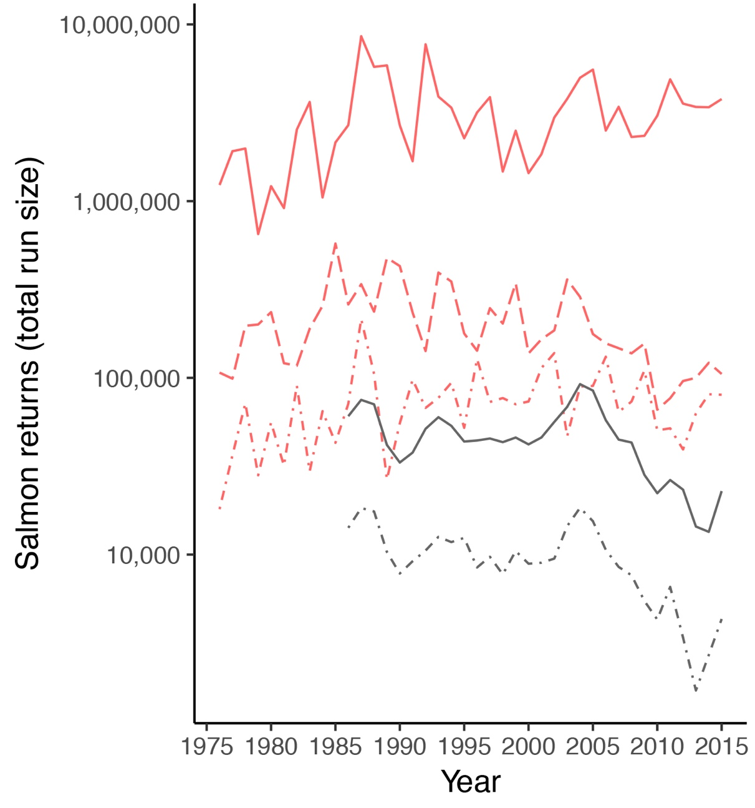
How do climatic and landscape changes affect salmon?
Salmon returns are highly variable
Over past 30-40 years: Sockeye and Chinook returns varied ~10-fold in 5 Kenai River stocks
Over past 4,000 years: Major, multi-century fluctuations in Sockeye abundance (McCarthy et al. 2018)
Climatic oscillations generally explain some but not all of this variability
Portfolio effect: Intact, diverse landscapes support more stable aggregate salmon returns than fragmented, homogenous landscapes (Schindler et al. 2010, Griffiths et al. 2014)
10 x
Sockeye
Chinook
Data: ADF&G, Art: Timothy Knepp

Slide 21
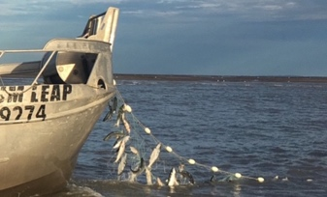
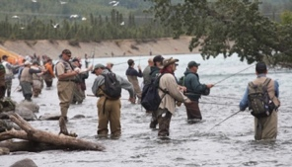
Fisheries harvest
Salmon are extremely valuable statewide
Commercial and sport fisheries for AK salmon generate $1 billion annually in gross economic output
In Cook Inlet, all sectors increasingly focused on Sockeye
Chinook decline has forced closures and aggravated tensions between user groups
Commercial
Salmon harvest (thousands), Northern Kenai Peninsula
Photo credits: Madeline Jovanovich, Ron Neibrugge, jodyo.photos
Sport
Personal use
Data from ADF&G
John Schoen

Slide 22
Stabilizing the booms and busts of fishing revenues
Fishing communities that participate in more diverse fisheries enjoy more stable revenues
Across Alaska (Sethi et al. 2014)
Within Kenai Peninsula (our study)
However, most fishing communities on Kenai Peninsula have specialized on fewer fisheries over time
This could reduce economic resilience to major changes like climatic regime shifts (Cline et al. 2017)
How can policy makers and fishing communities promote diversification and flexibility?
Peninsula Clarion

Slide 23
What does the future hold?
Serious risks, new opportunities, and disruption
Lowland salmon streams are especially vulnerable to losses
Warming stream temps
Wetland drying
Human development
Invasive species
Glacial retreat offers opportunities for salmon production gains in some heavily glaciated watersheds
New proglacial lakes could be especially beneficial
Policy and management can benefit from a clear-eyed assessment of the risks, and also acknowledging the potential opportunities

Slide 24
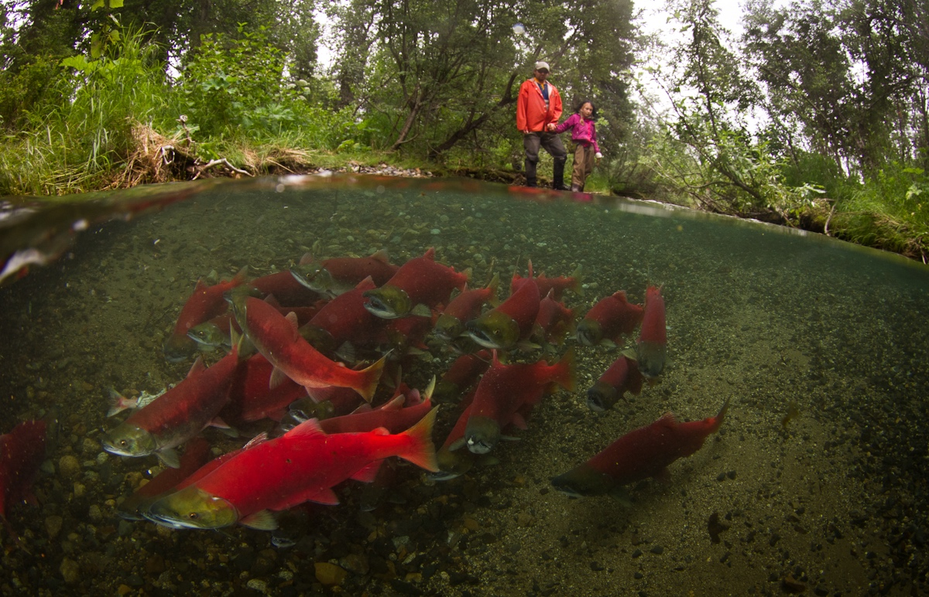
Take-home message for Alaskans: We have local control over many factors influencing our future salmon runs
Maintaining a diversity of options
Strong habitat protections
Economic diversification
may allow salmon runs and fishing communities to continue to thrive in the face of change
Jonny Armstrong

Slide 25
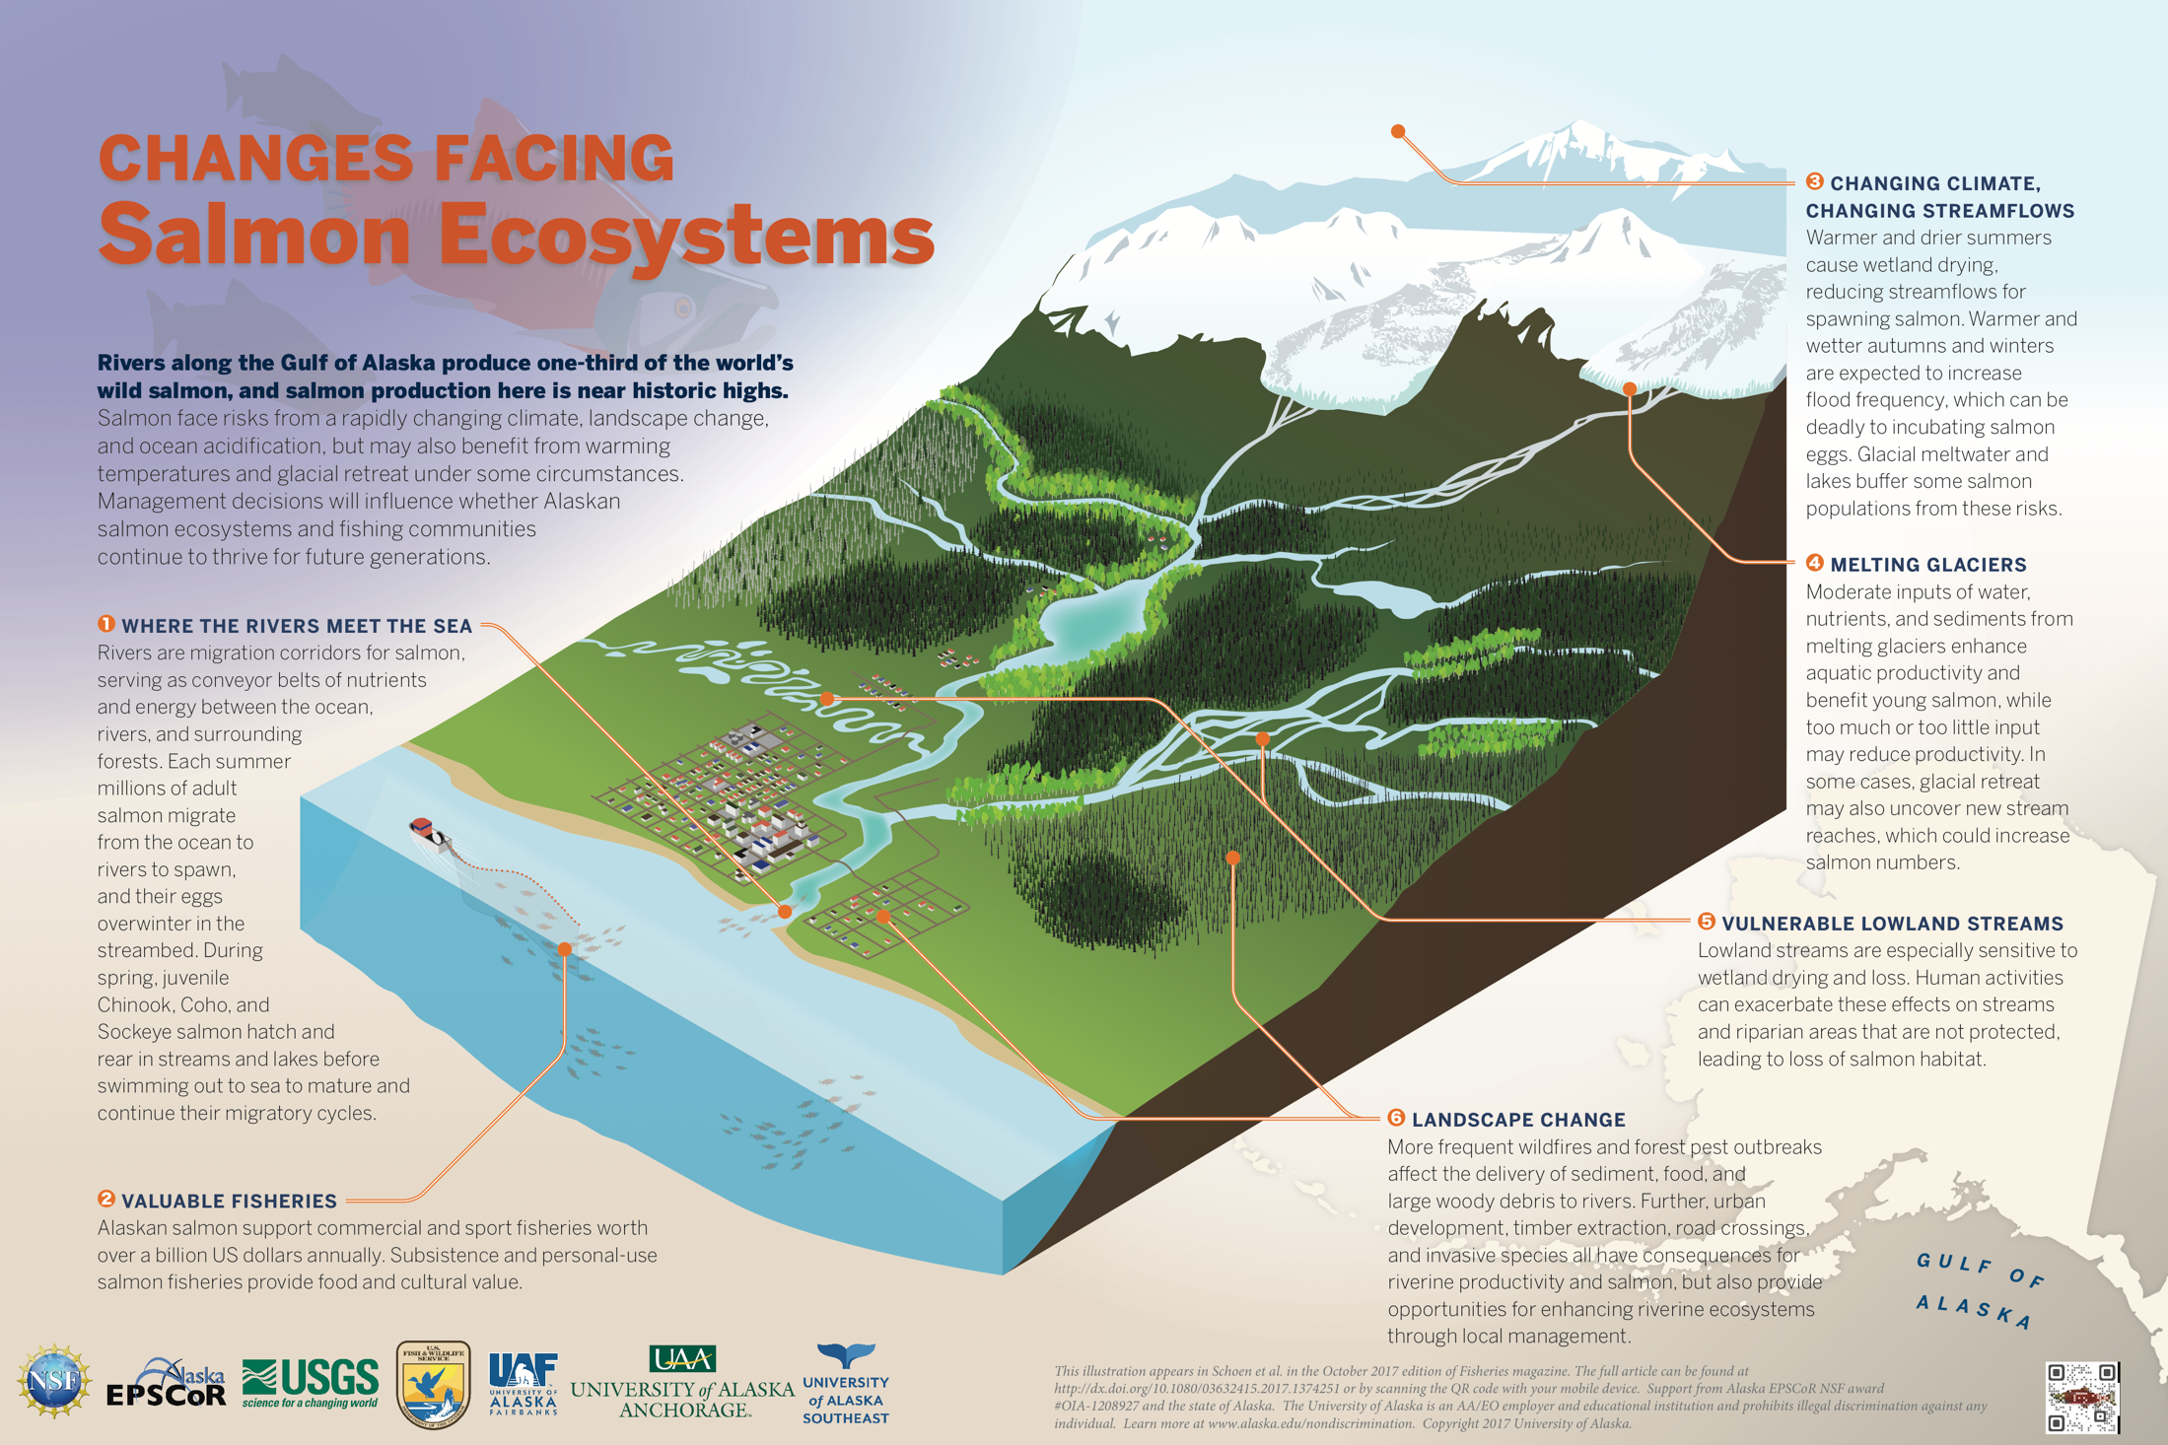
Poster for public outreach
(free download at www.alaska.edu/epscor/pdfs/Salmon-Ecosystems.pdf)

Slide 26

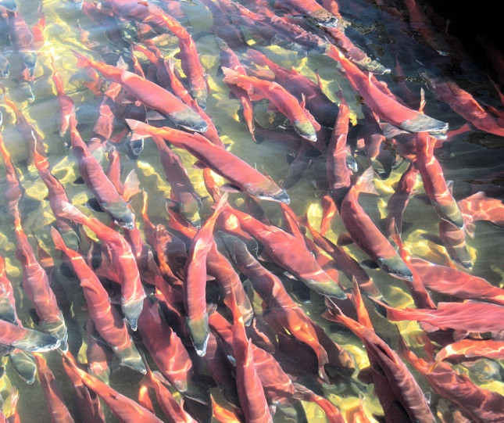
Thanks!
NSF Award
#OIA-1208927 with matching funds from the State of Alaska
We thank Robert Begich, Ed Berg, Branden Bornemann, Jeff Falke, Steve Fleischman, Rudiger Gens, Sue Mauger, Sandy Milner, Shad O’Neel, Robert Ruffner, Daniel Schindler, Becky Shaftel, Al von Finster, Peter Westley, and Alaska EPSCoR program researchers for providing data, field and lab assistance, and valuable discussions.
Dave Merrill
John Schoen

Slide 27
Glacial meltwater can buffer salmon streams from drought
Hotter, drier summers in Kenai Lowlands reduced available water by 60% since 1968 (Berg et al. 2009)
Yet, flows in mainstem Kenai River have remained stable
Buffered from drought by glacial meltwater
Protects spawning and rearing salmon during hot, dry summers
Berg et al. 2009
Schoen et al. 2017, USGS data

Slide 28
Glaciers + Lakes = High Salmon Productivity?
Glacial rivers are generally less biologically productive than non-glacial rivers (Milner et al. 2001)
  Unstable beds and banks
  Silty
  Cold
Proglacial lakes moderate these harsh conditions, supporting large salmon runs in rivers downstream (Dorava and Milner 2000)
  E.g., Kenai, Kasilof, Klutina, Tonsina
Run timing diversity (early and late runs) extends availability of salmon to ecosystems and fisheries
The distribution of proglacial lakes is changing. How will this affect salmon?
Glacial river (no lake)
Marli Miller, U Oregon
Glacial river below lake
John Schoen

Slide 29
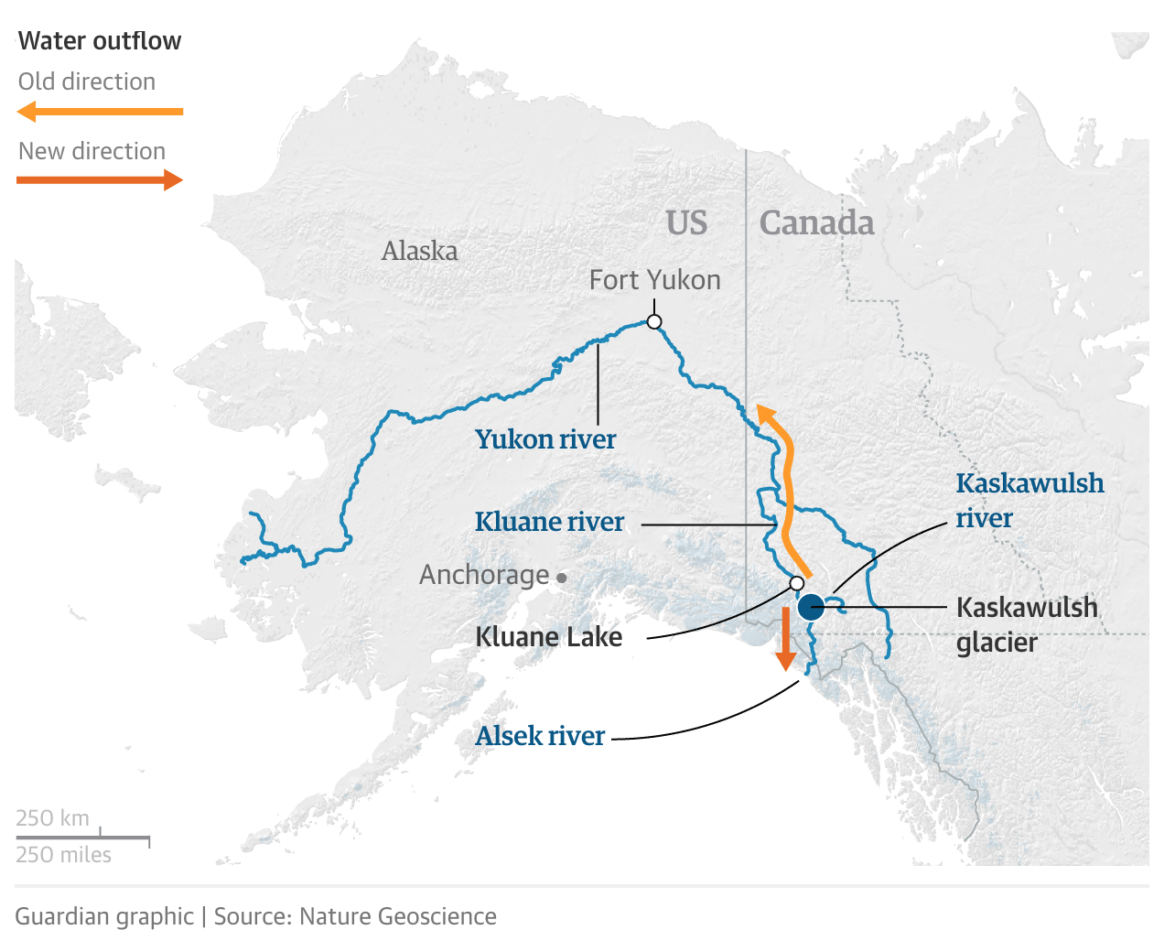
Glacial river now flows into Pacific
Old direction
New direction

