Slide 1
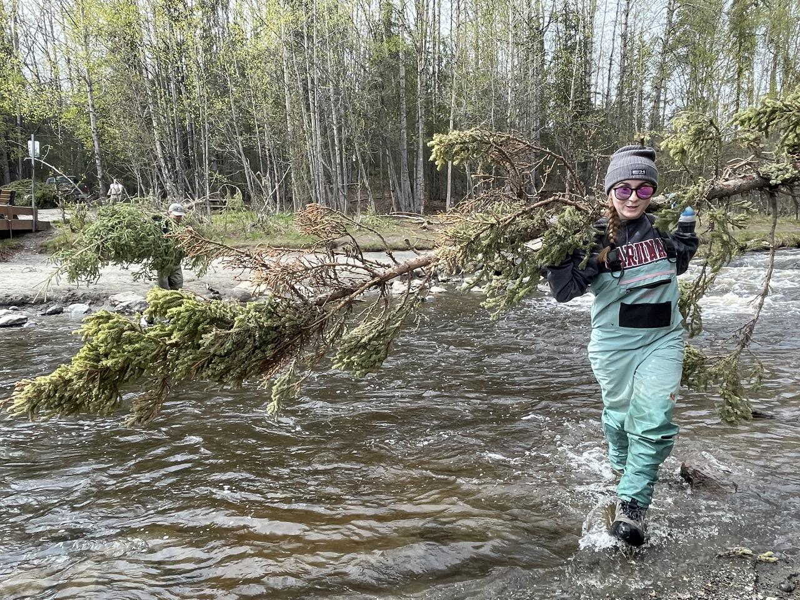
Banking on the Kenai River:
From Homestead
to Conservation Easement
Soldotna Chamber of Commerce March 13, 2024
Brandon Drzazgowski, Benjamin Meyer (Kenai Watershed Forum) Joel Cooper (Kachemak Heritage Land Trust)

Slide 2
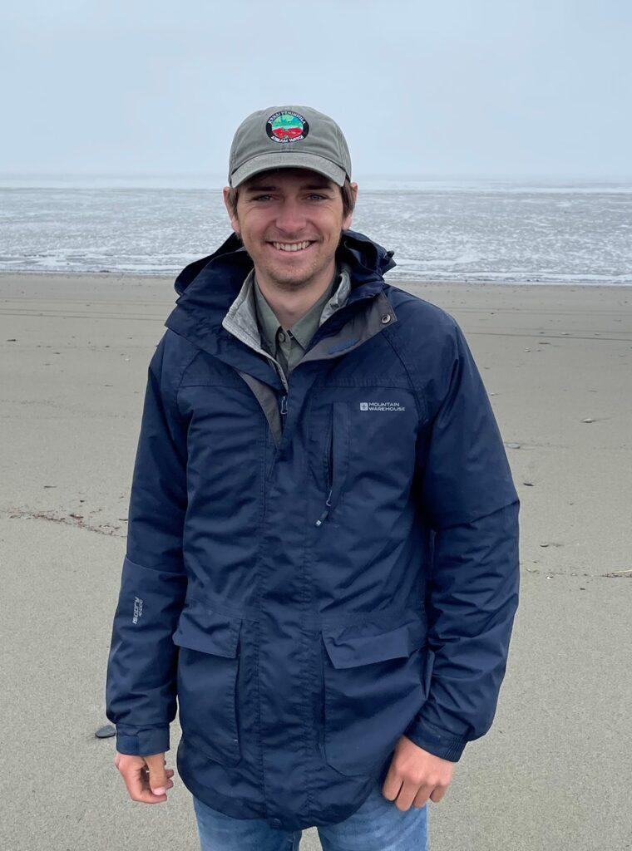
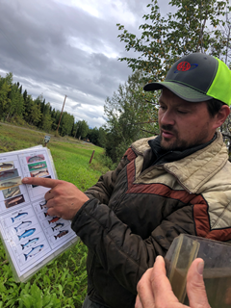
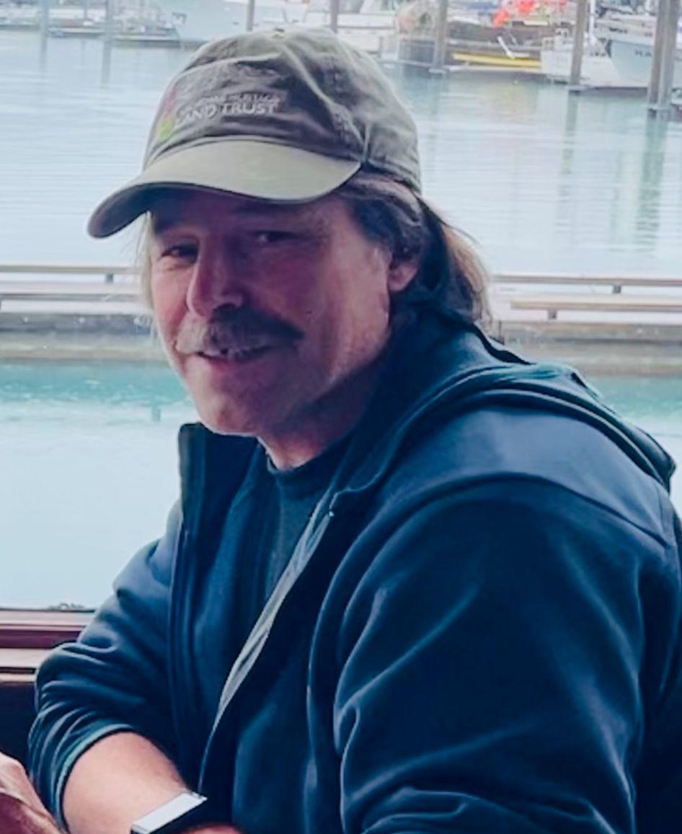
Who are we?
Brandon Drzazgowski Stream Watch Coordinator
Benjamin Meyer Environmental Scientist
Joel Cooper Stewardship Director
Notes:
Each intro ourselfs

Slide 3
What does the Kenai Watershed Forum do?
“Working Together for Healthy Watersheds since 1997”
Research Restoration Education
Notes:
Ben

Slide 4
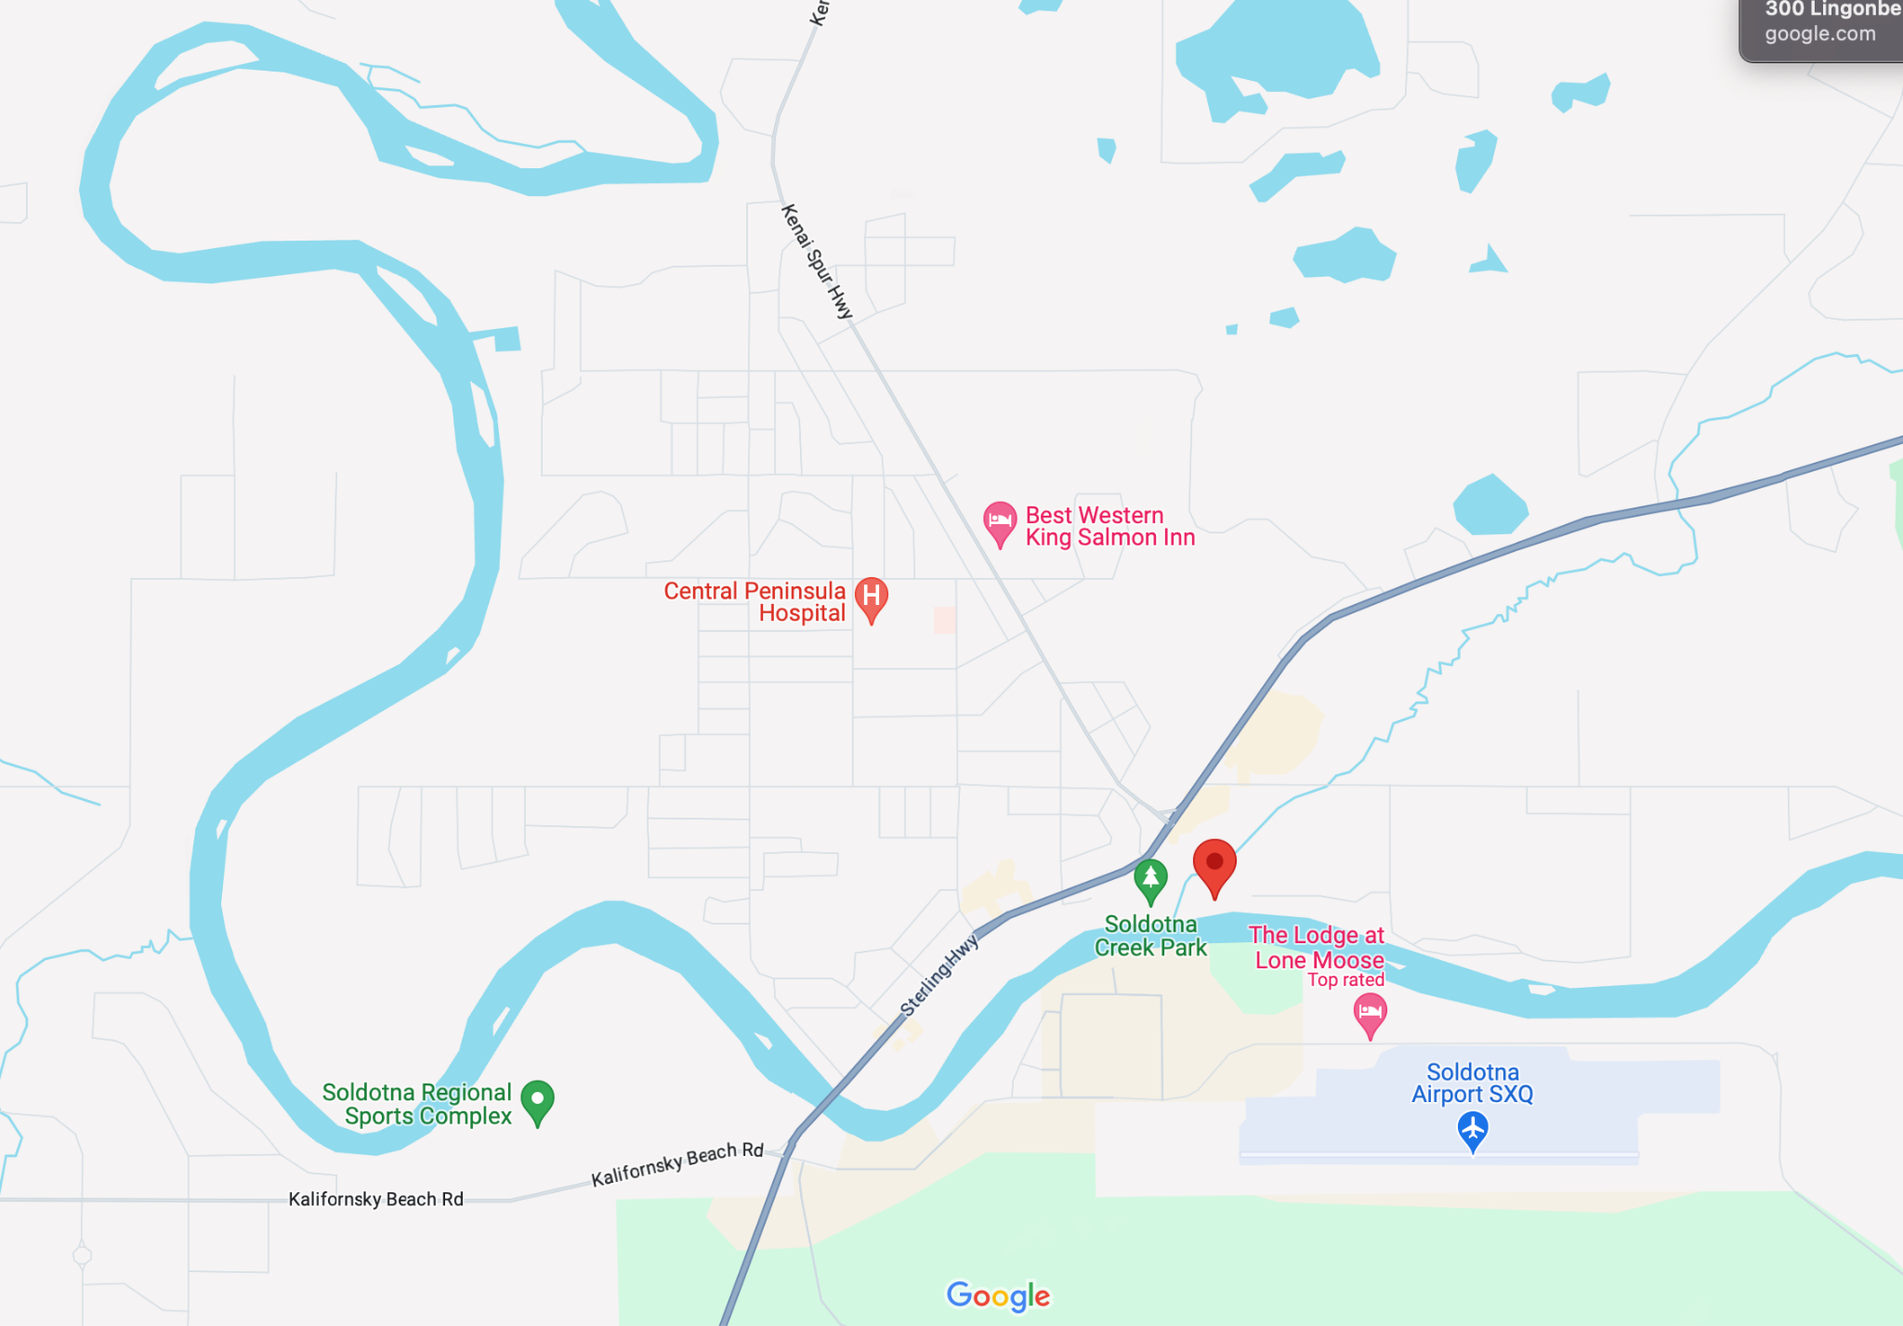
Project Location
Mullen Parcel, at mouth of Soldotna Creek
Notes:
Ben

Slide 5
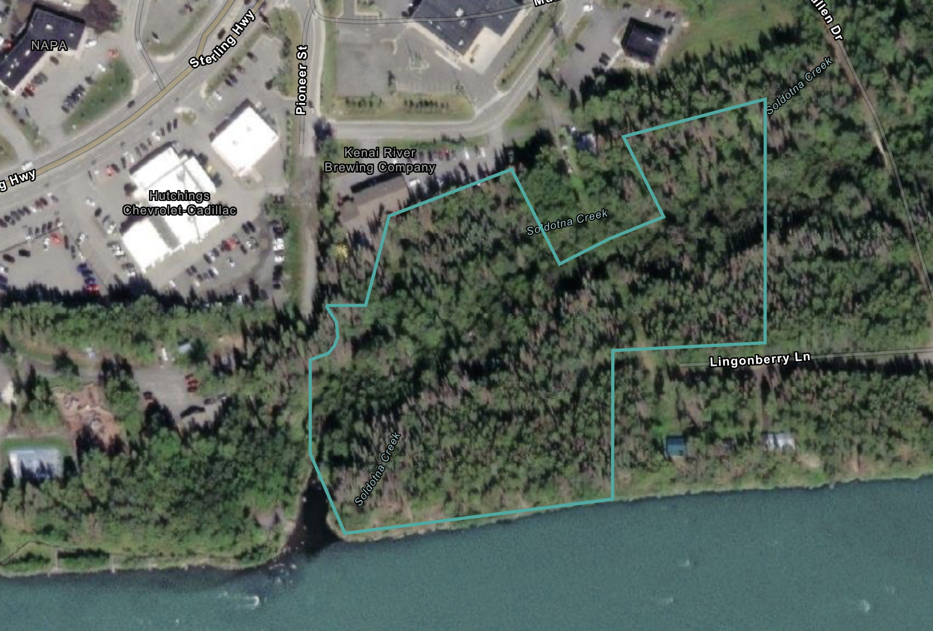
The Mullen Parcel
Originally owned by the Mullen Family, early Soldotna homesteaders
The Mullen family conveyed the property to the State of Alaska in 1999, subject to the Conservation Easement held by Kachemak Heritage Land trust
Owned/managed by ADF&G and Alaska State Parks
River bank is degraded from shoreline trampling
Fred Meyer
Degraded Shoreline Area
Notes:
Ben

Slide 6
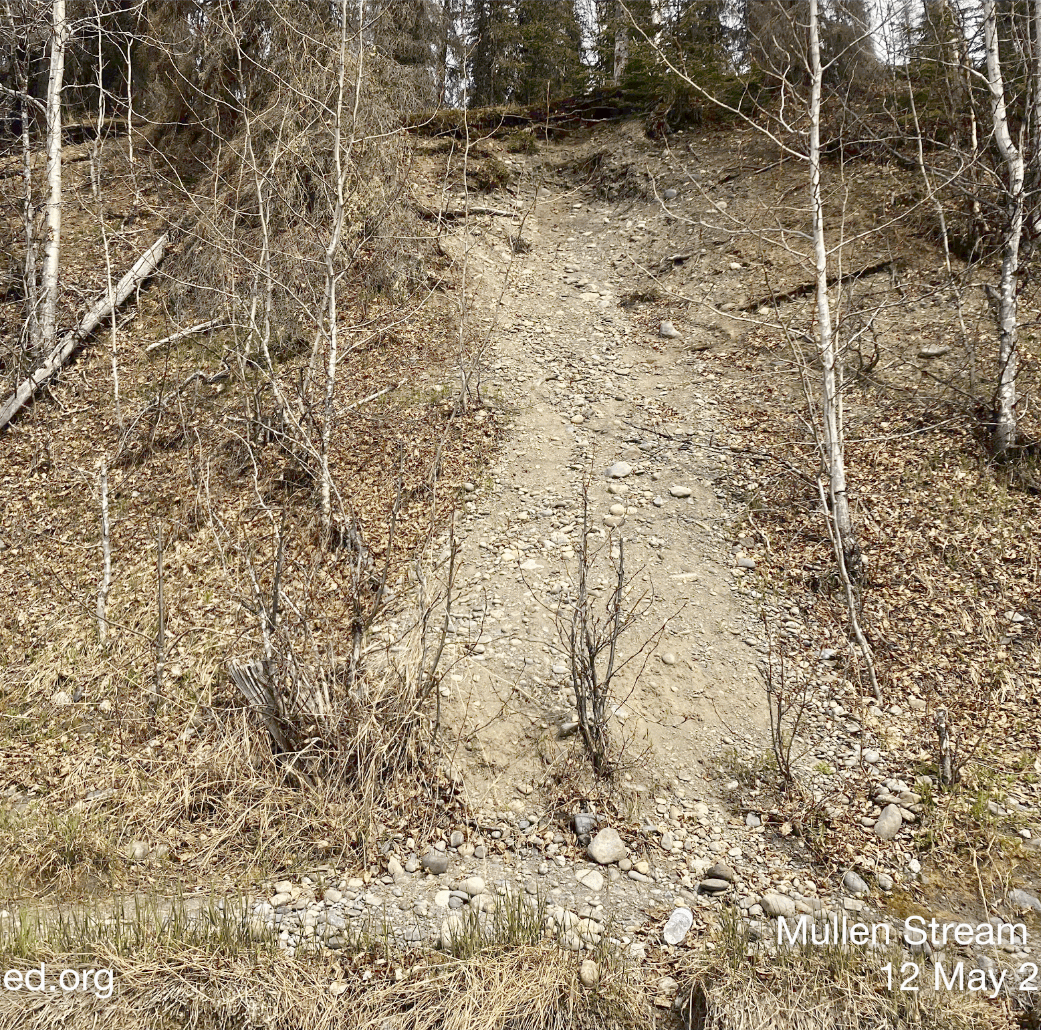
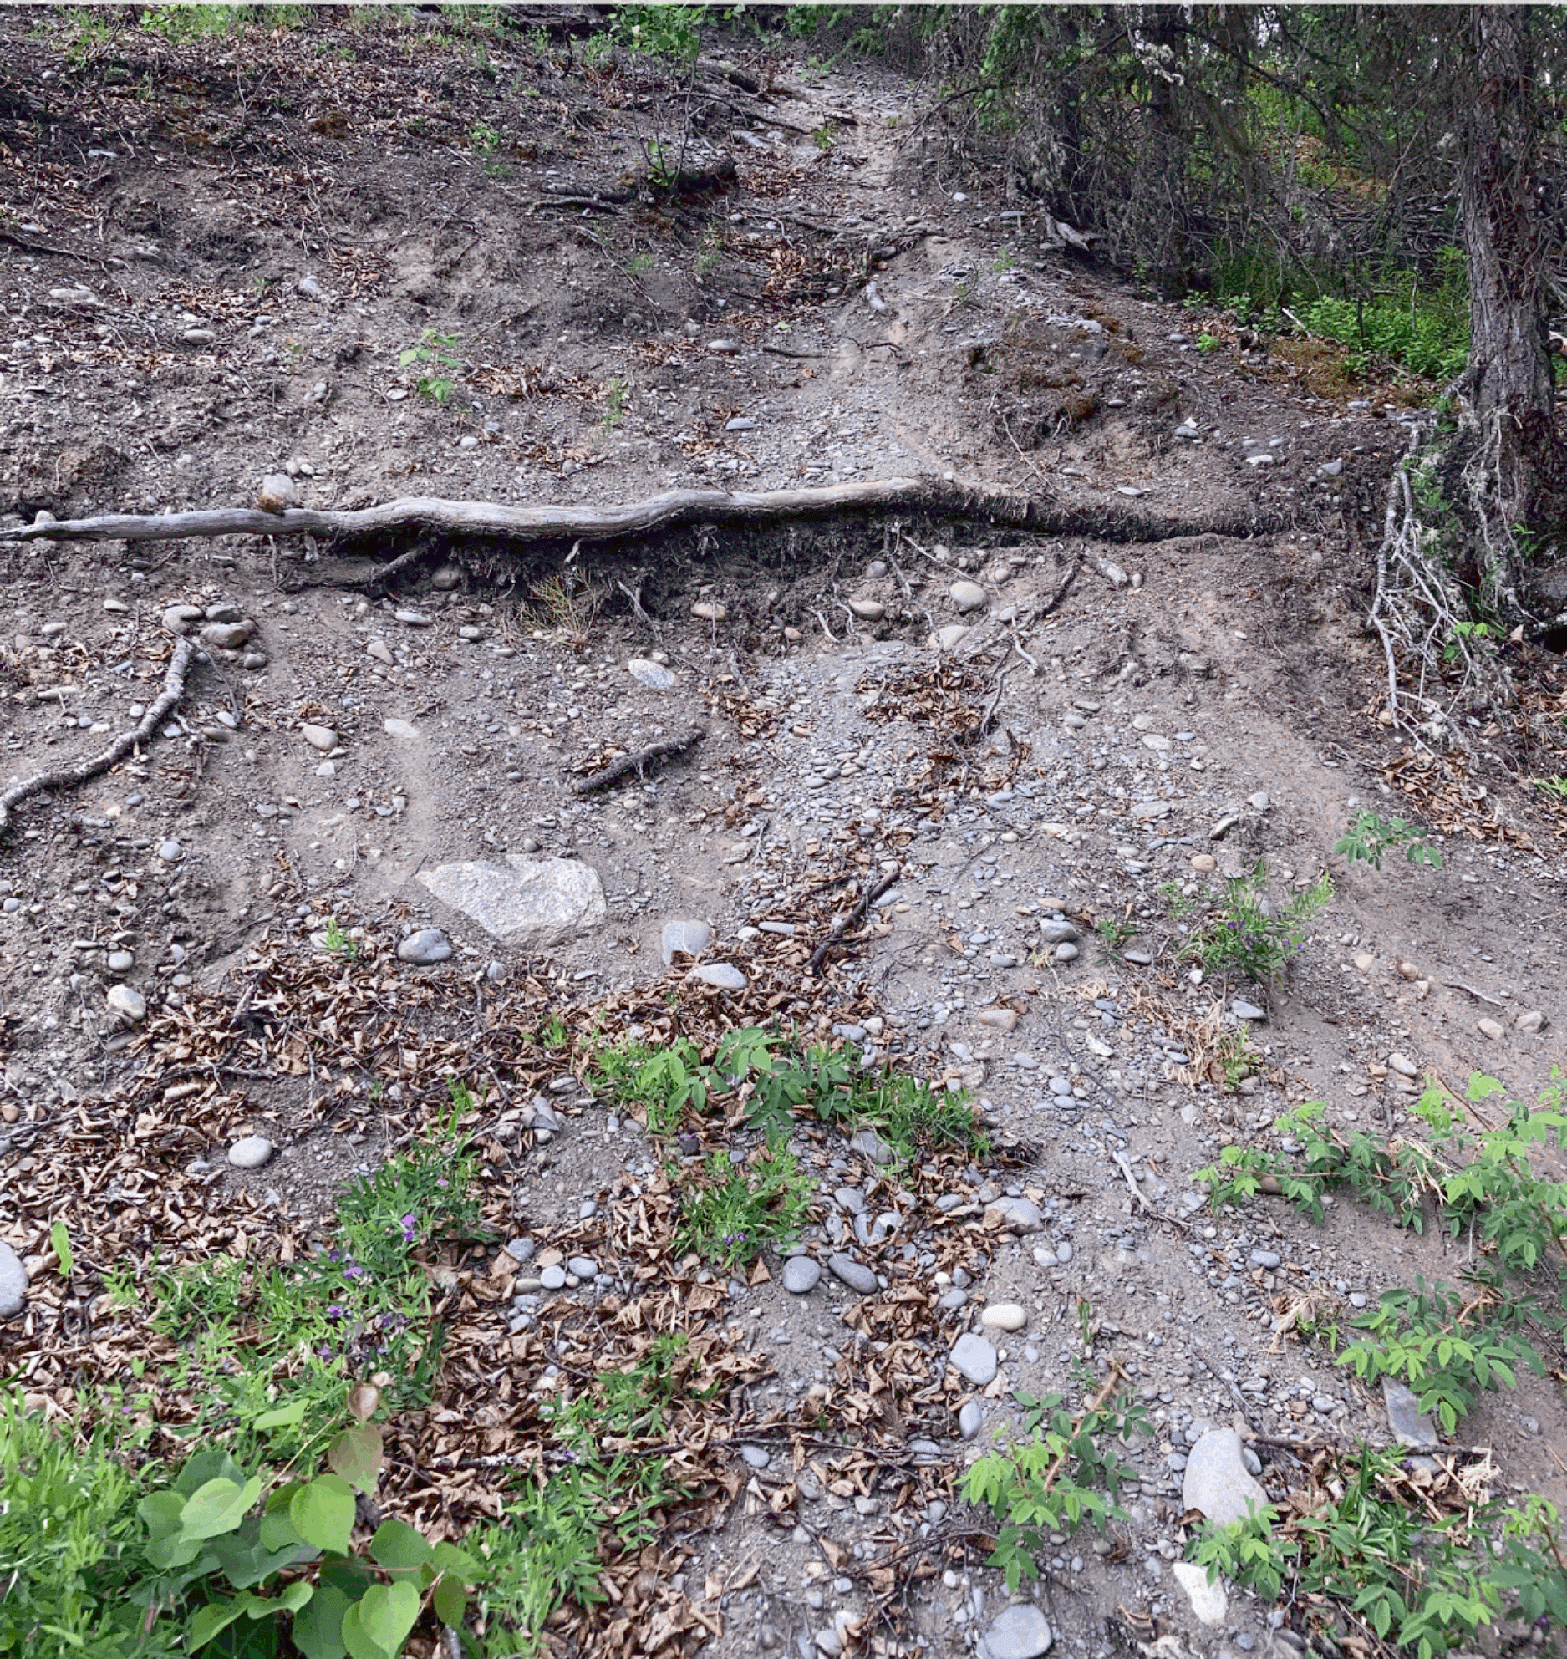
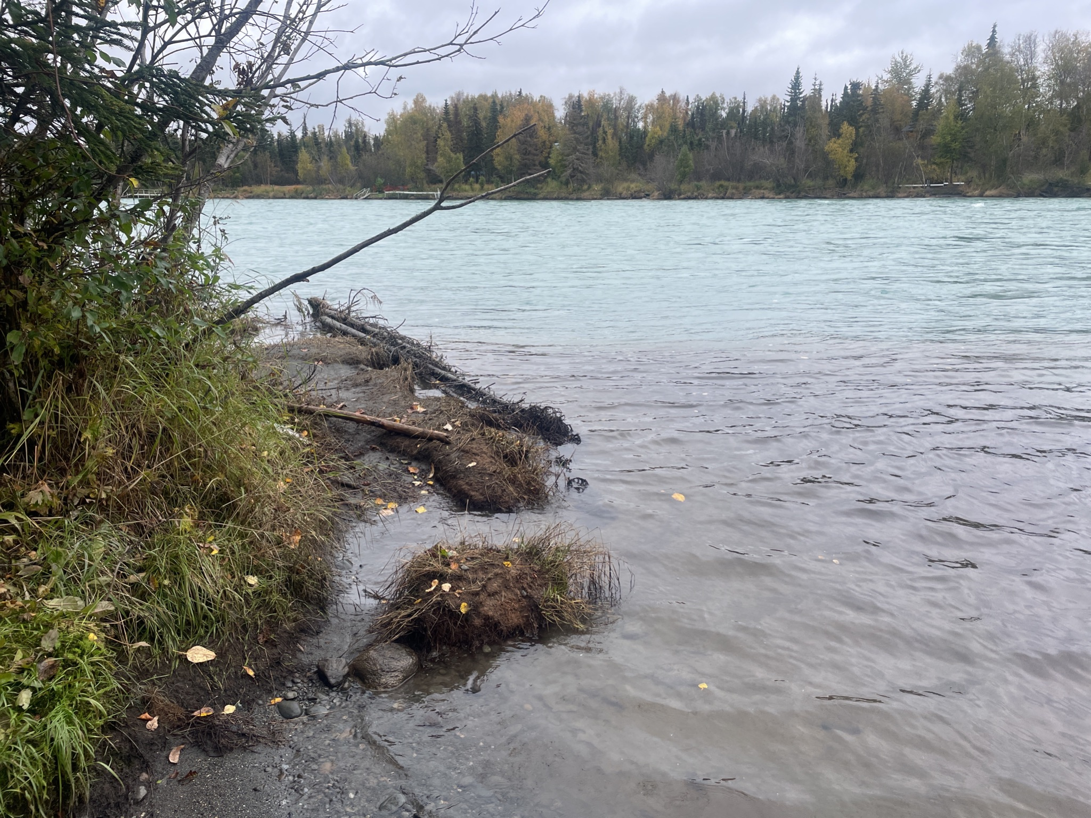
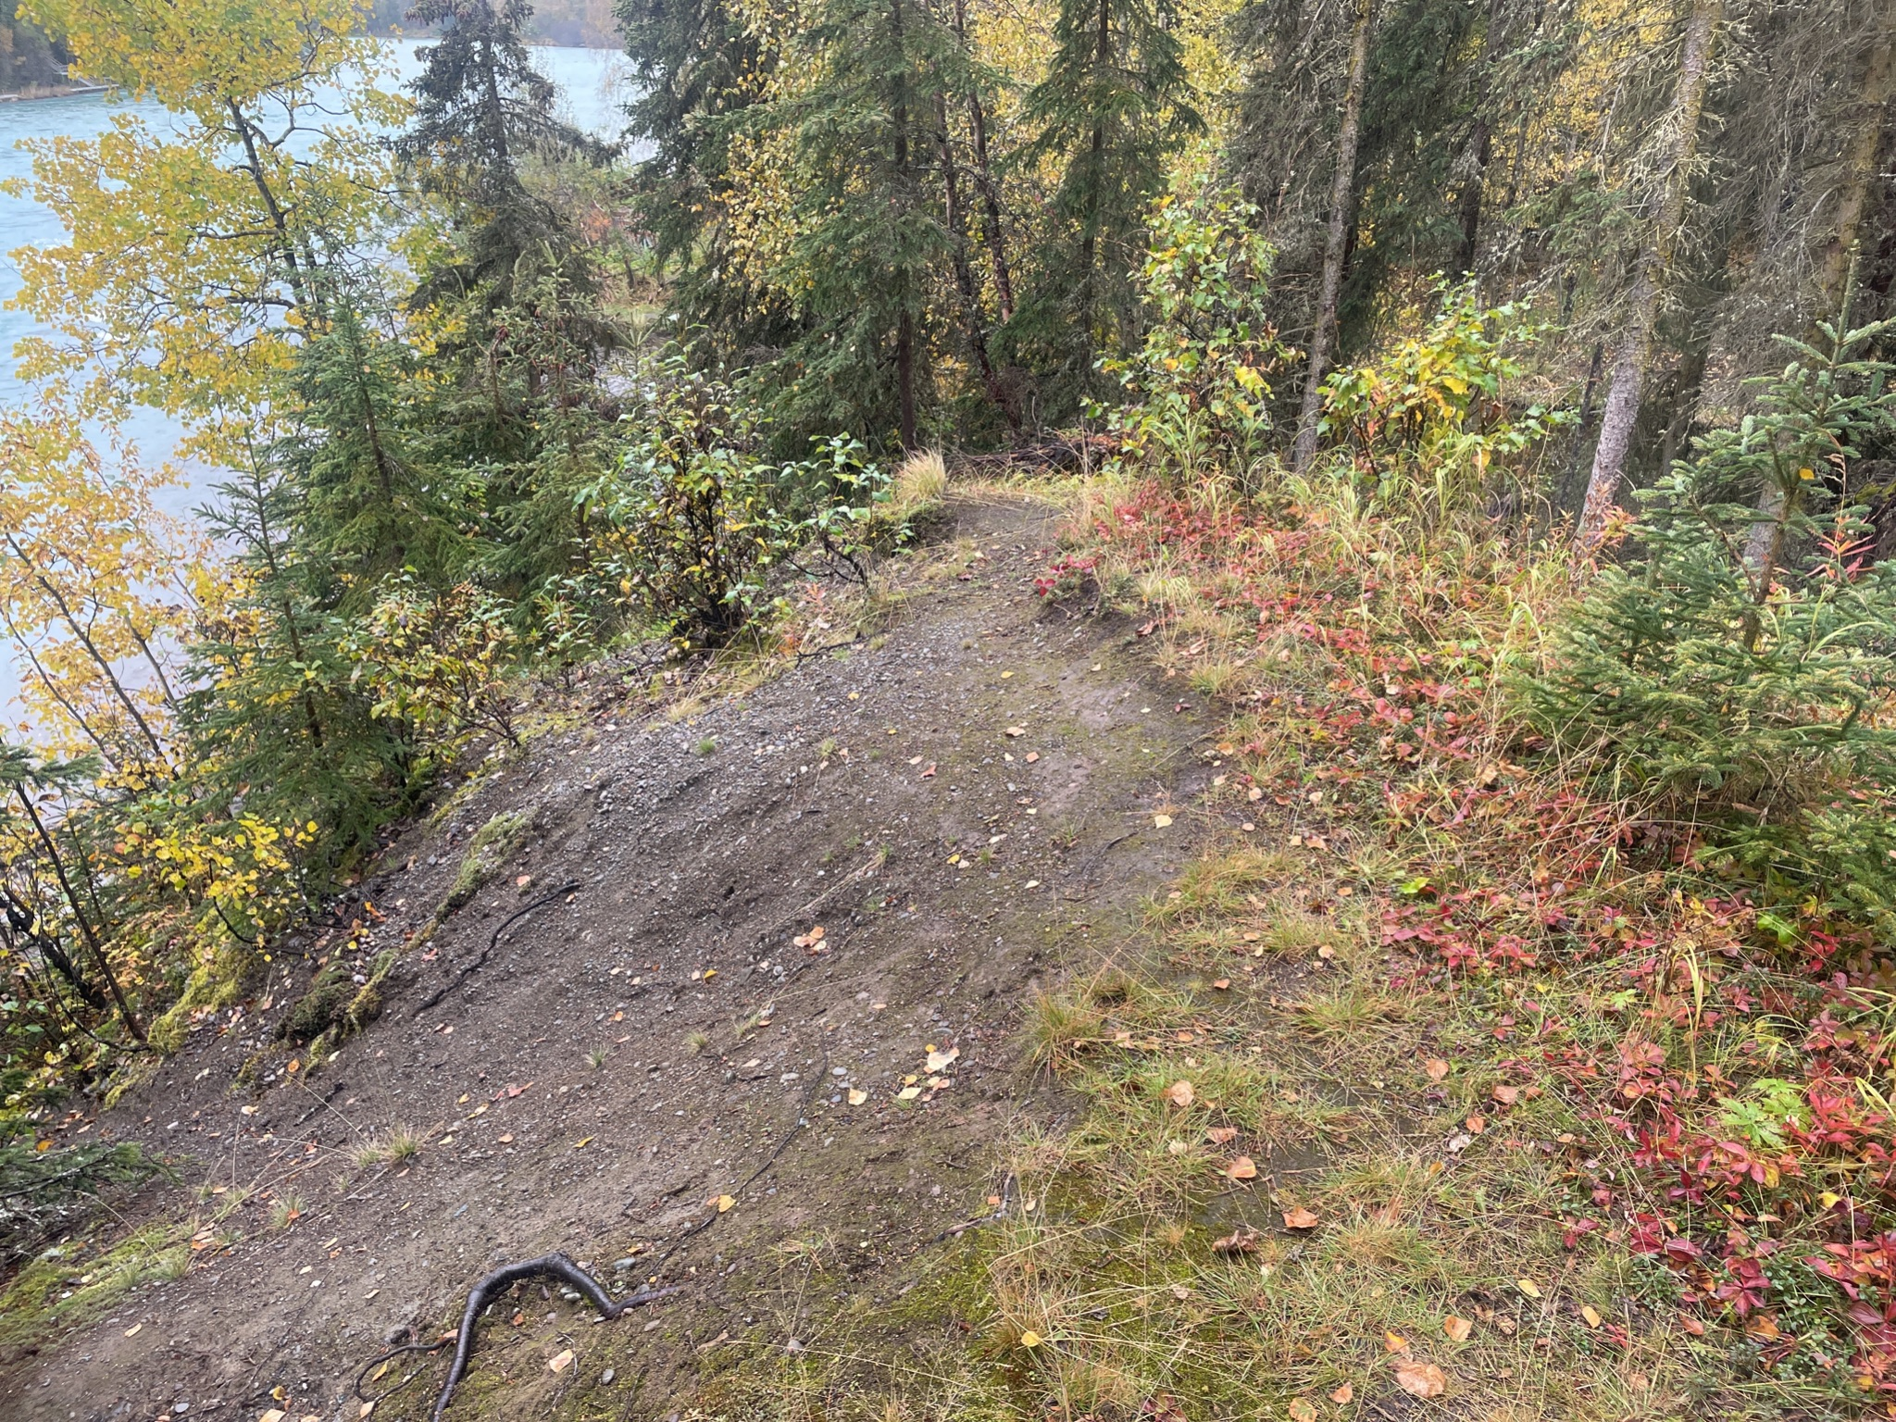
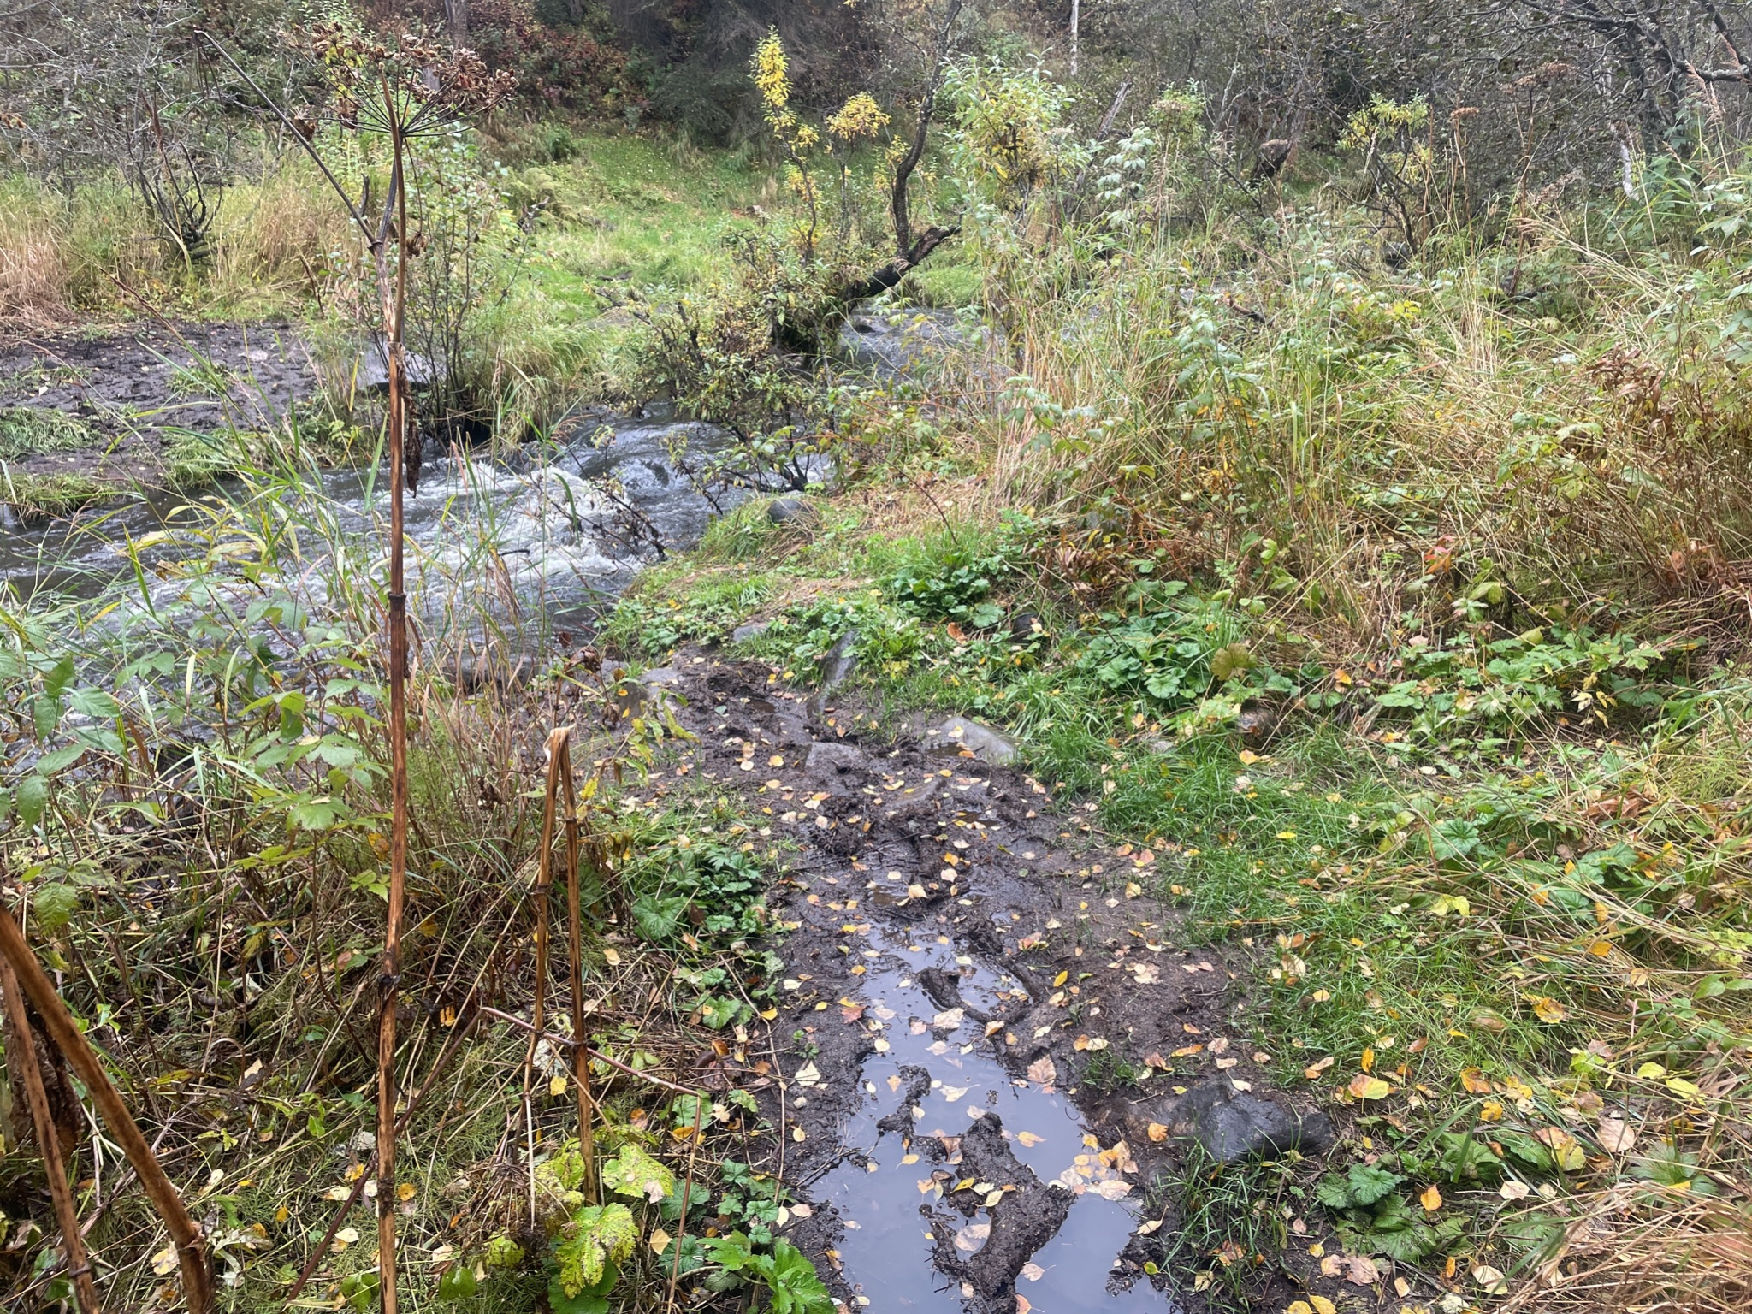
The Problem
Vegetation trampling
Angler access on restricted shore
Accelerated erosion
High water velocity location
Loss of root systems
Accumulation of litter
Notes:
Ben

Slide 7
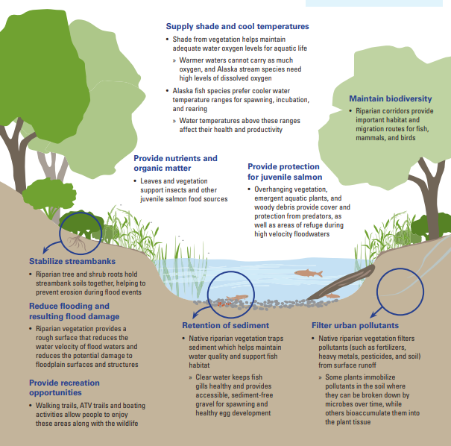
Do fish like degraded streambanks? (Answer: No)
Notes:
Ben

Slide 8
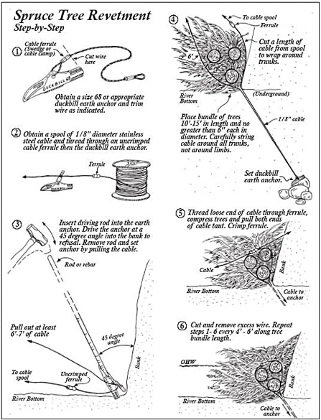
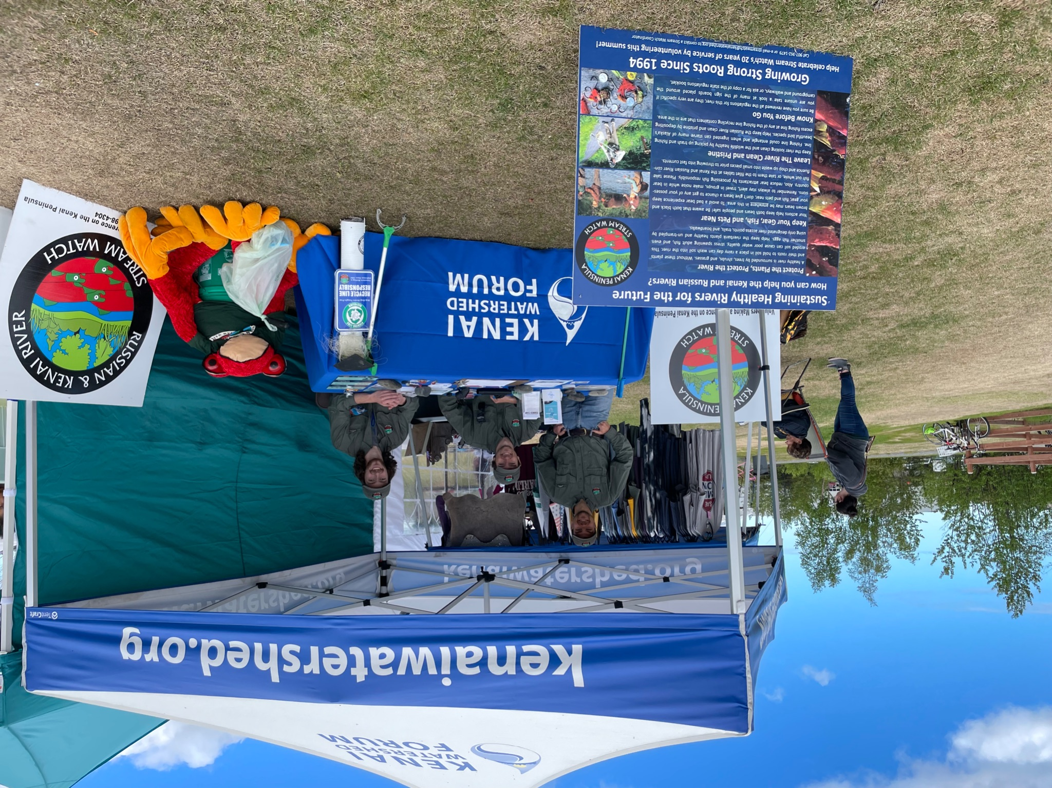
The solutions
Streambank restoration
Site monitoring
Education
Notes:
Brandon

Slide 9
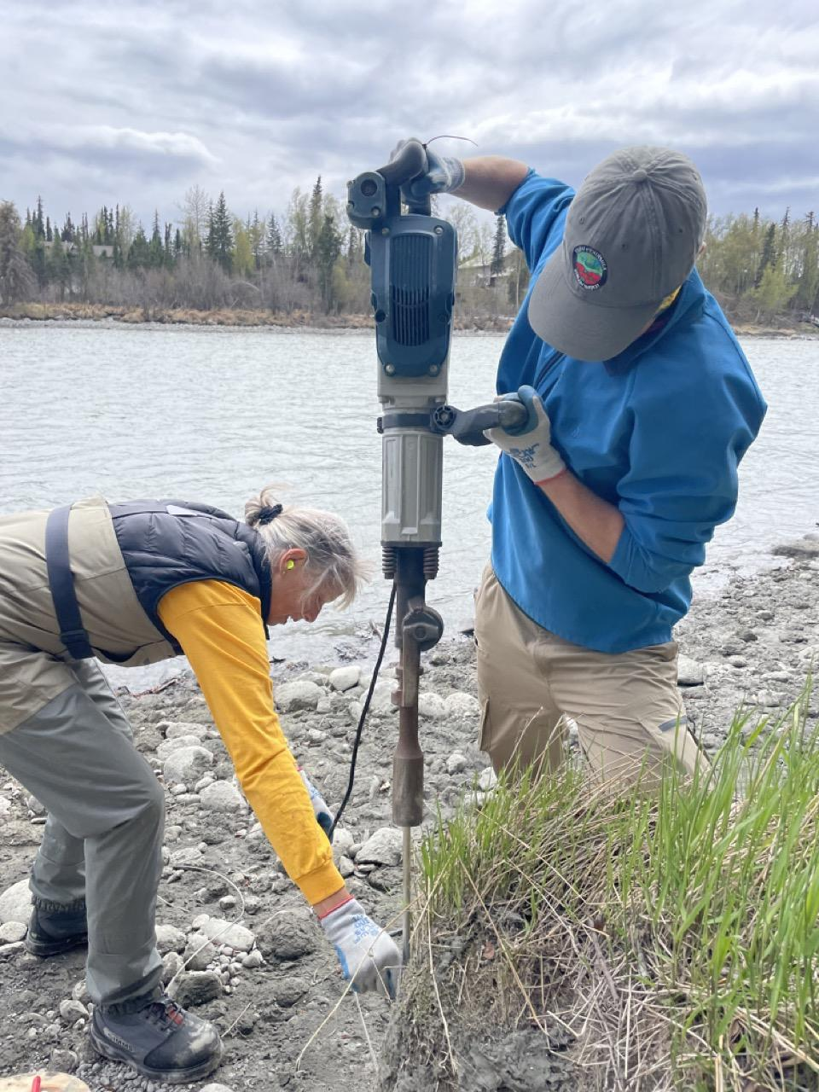
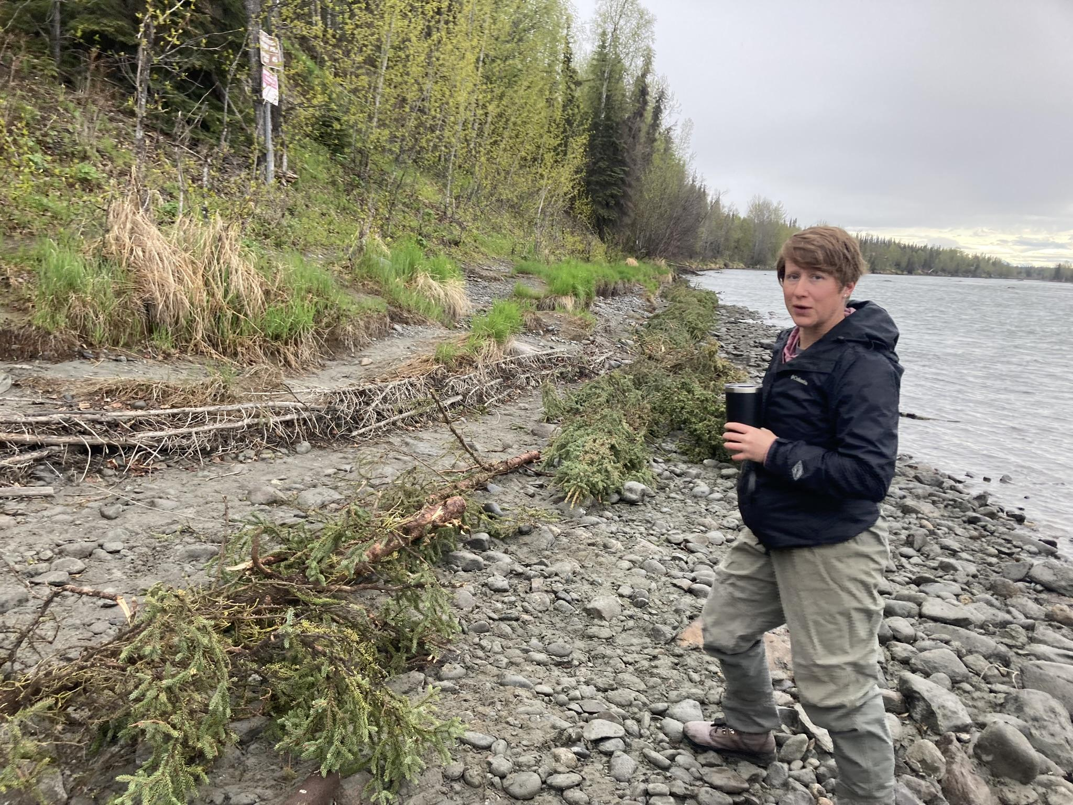
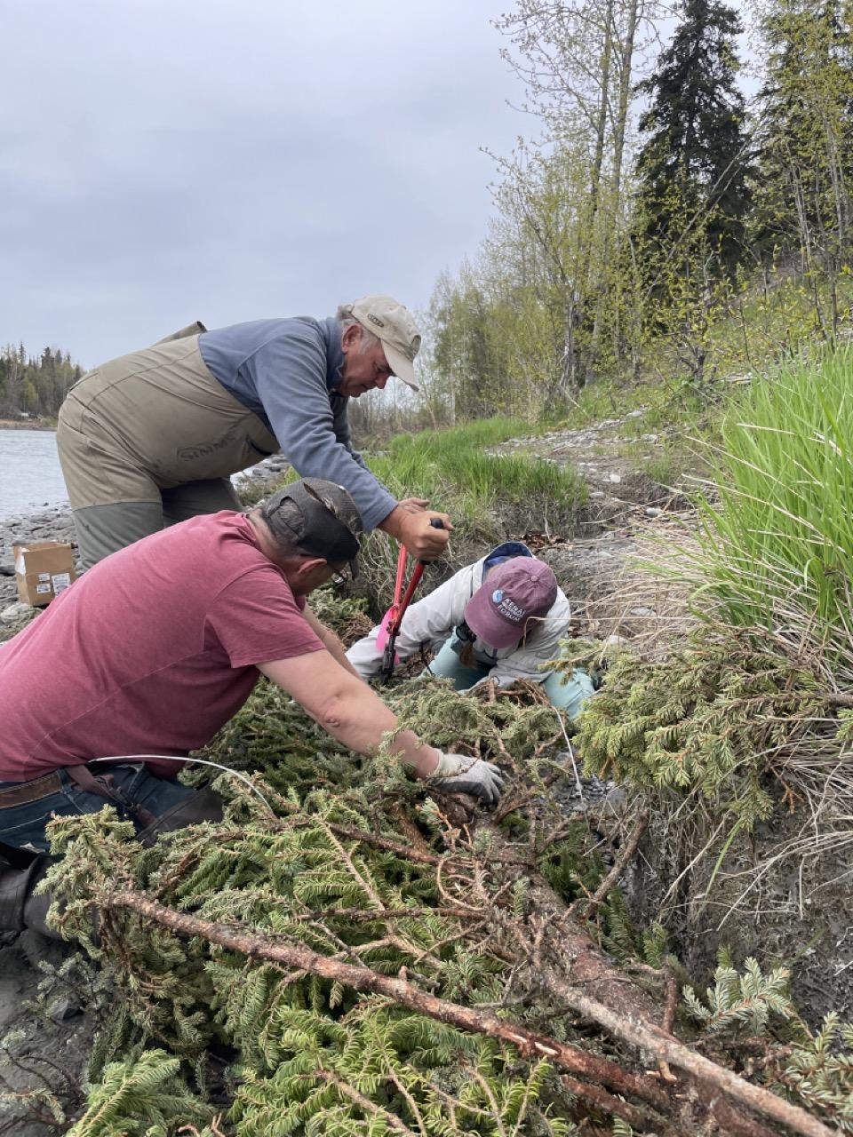
Streambank Restoration
Spruce cabling
Tree planting
Improved signage
Notes:
Brandon

Slide 10
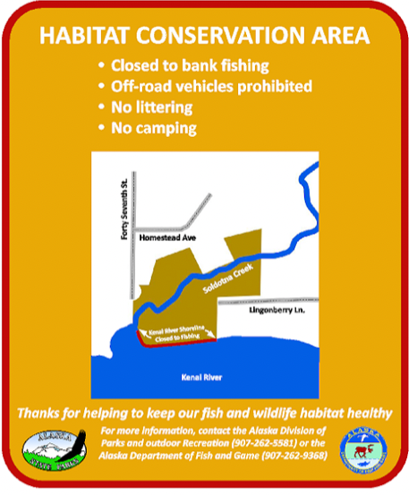
Streambank Restoration
Spruce cabling
Tree planting
Improved signage
Notes:
Brandon

Slide 11
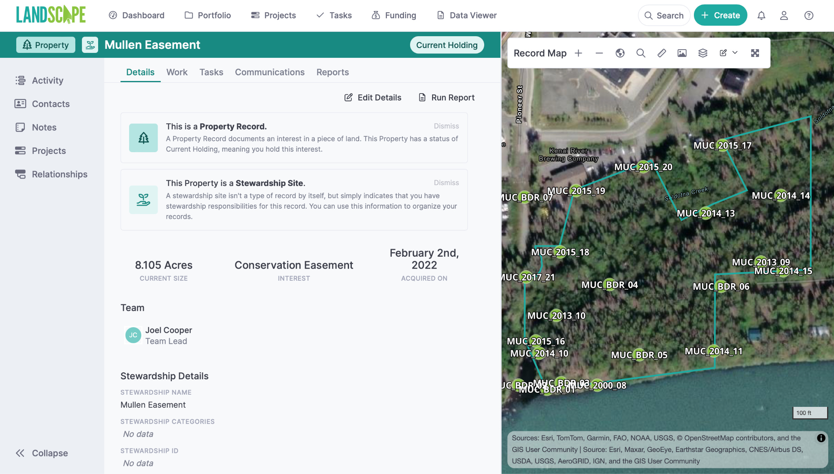
Site Monitoring
Bi weekly walking surveys along streambank/luff
Track usage, both permitted and unpermitted
Notes:
Brandon

Slide 12
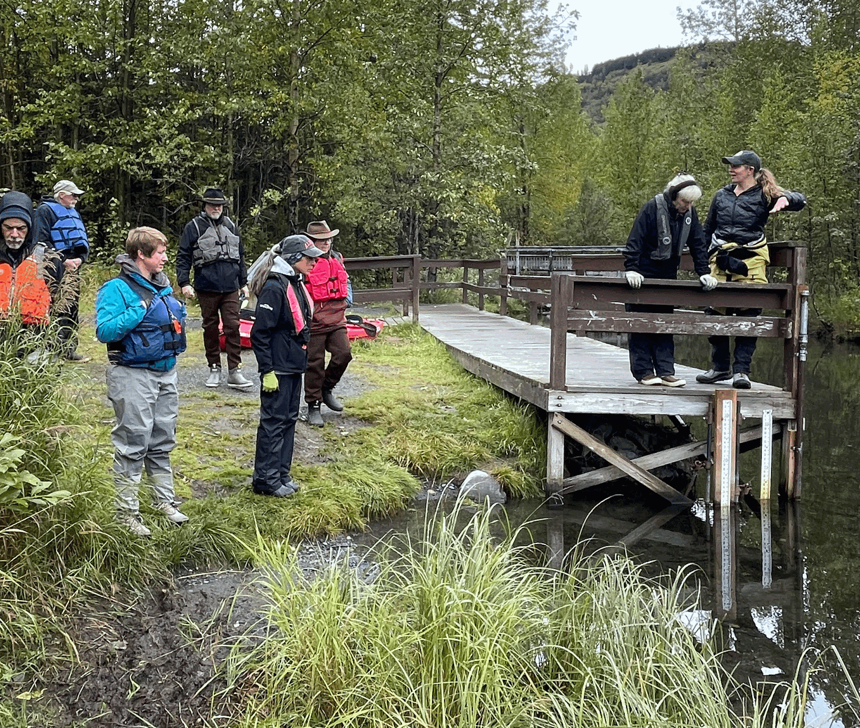
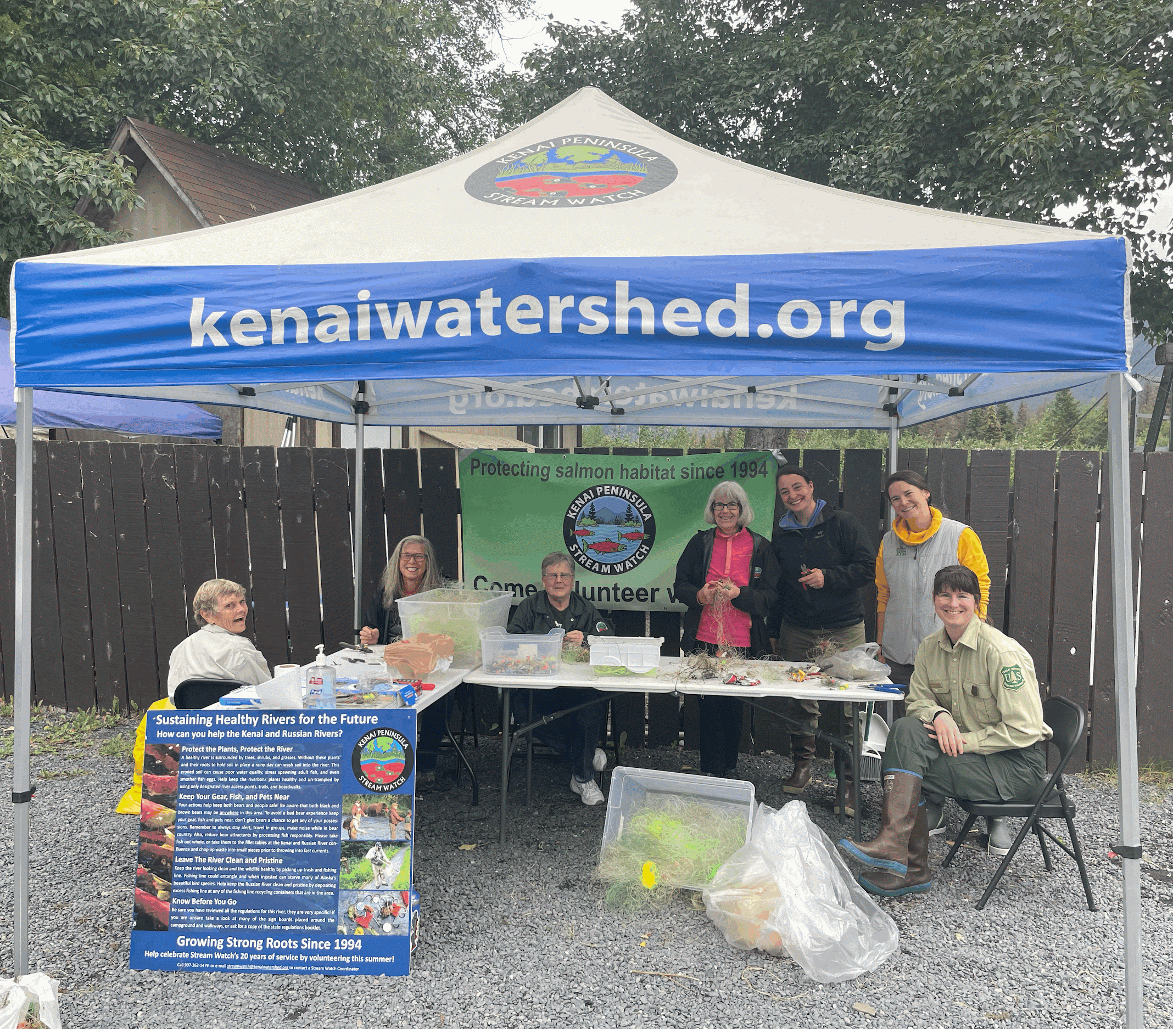
Education
Educational Booths
Social Media
Newsletters
Public Presentations
Getting others involved
Notes:
Brandon

Slide 13
Project Partners
Partners
Kachemak Heritage Land Trust
Mullen family
AK Sustainable Salmon Fund
AK State parks
AK Dept of Fish & Game
Kenai Watershed Forum
Notes:
Brandon

Slide 14
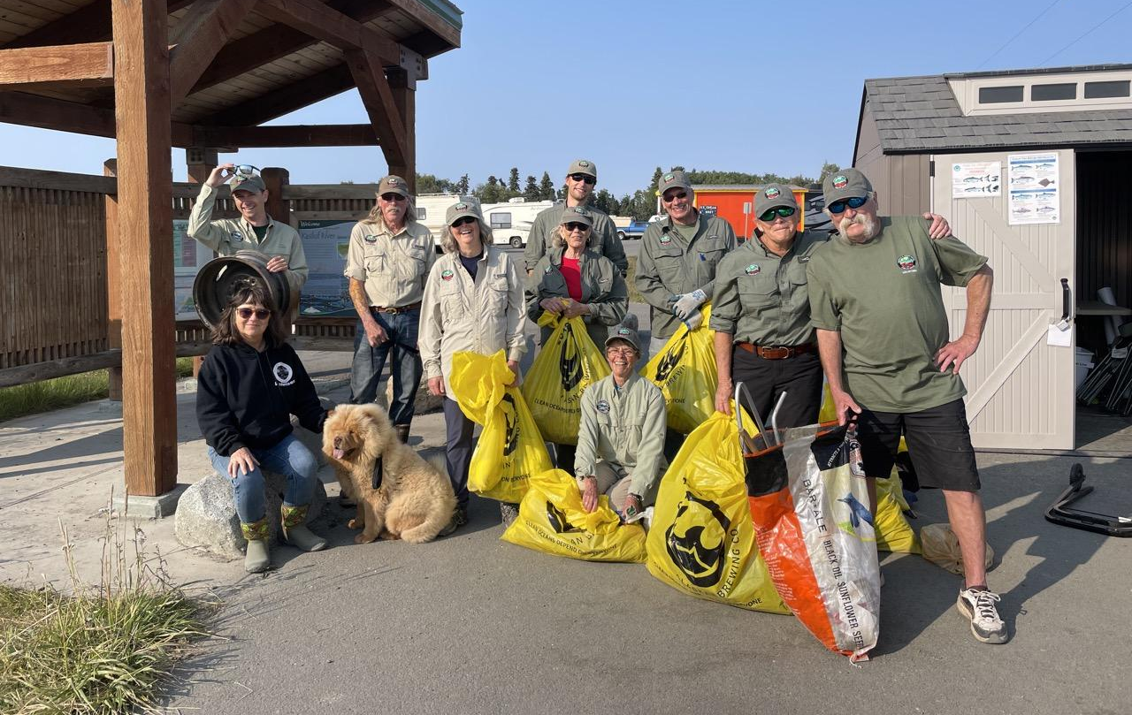
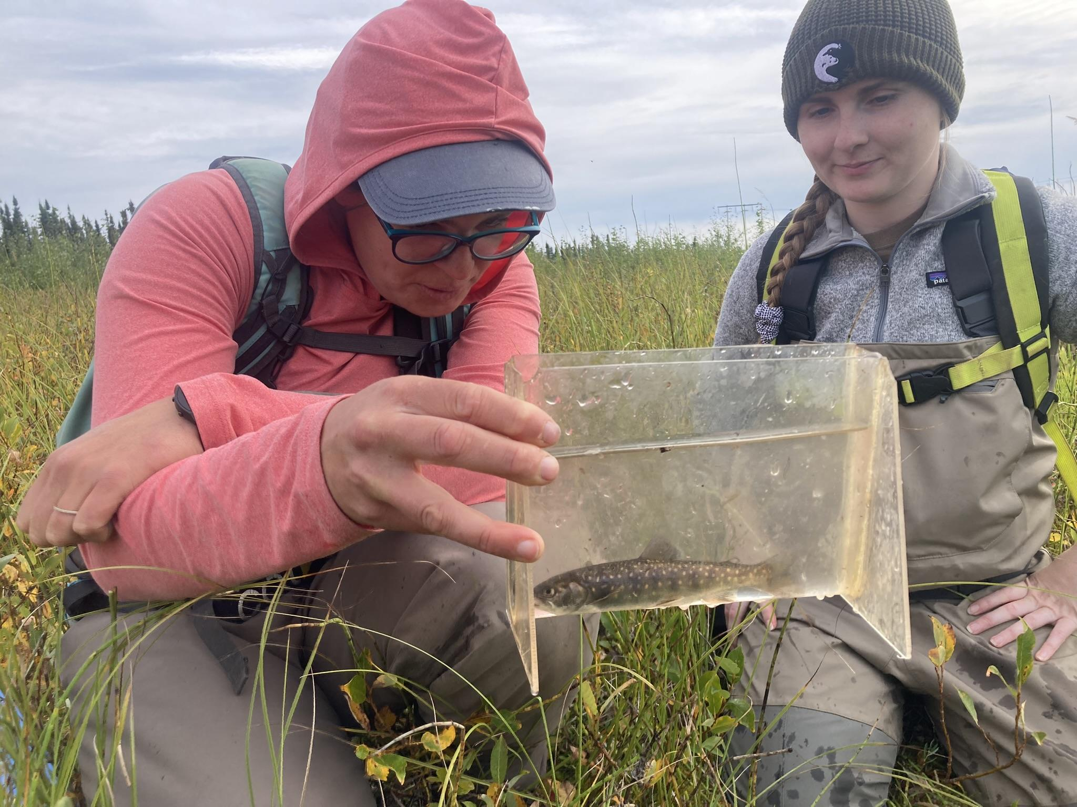
How you get involved?
Do you know more places like this?
(Complex access/conservation needs overlap)
Volunteer opportunities with this project and others
Summer Camps
How to get in touch with us
ben@kenaiwatershed.org
streamwatch@kenaiwatershed.org
Notes:
Brandon

Slide 15
Thank you!
This project receives support from:
AKSSF grant #56009
Kachemak Heritage Land Trust
Mullen Family
Our awesome volunteers

